Slide 1
Effect of Bit-Level Correlation in Stochastic Computing
Megha Parhi, Marc D. Riedel, Keshab K. Parhi
Department of Electrical and Computer Engineering
University of Minnesota, Minneapolis MN, USA

Slide 2
Outline
Introduction
Objective
Theoretical Results
Simulated Results
Conclusions and Future Work

Slide 3


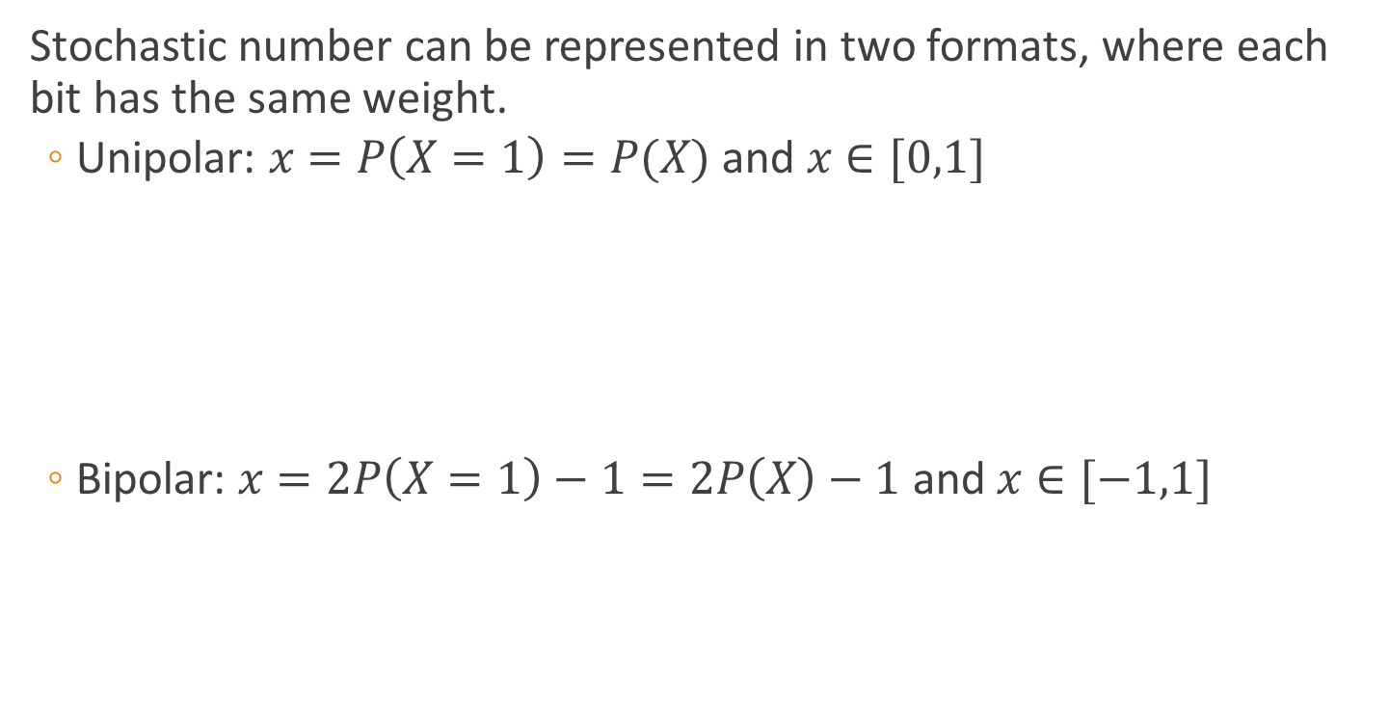
Stochastic Computing
Stochastic number can be represented in two formats, where each bit has the same weight.
  Unipolar: $x=P\left(X=1\right)=P(X)$ and $x∈[0,1]$
  Bipolar: $x=2P\left(X=1\right)−1=2P\left(X\right)−1$ and$x∈[−1,1]$

Slide 4
Properties of Stochastic Computing
Stochastic Computing: A number is represented by a string of 1’s and 0’s. The percent of 1’s in the number represents the value of the number represented as a probability. It was proposed in 1967 by Gaines as an alternative to binary computing. Stochastic logic gates compute an approximation of the output as opposed to an exact value.
Applications: These are well suited in low-speed area-constrained applications such as biomedical applications, and cyber-physical systems operating at low rates.
Advantages:
  Low complexity in computing, small in size, low power
  Fault-tolerance due to redundancy
Disadvantages
  Long computation time (if bit stream is long)
  Low Accuracy (if bit stream is short)
  Multiplying by 2 and checking sign in bipolar are expensive operations

Slide 5
Example of Stochastic Multiplication

Slide 6
Outline
Introduction
Objective
Theoretical Results
Simulated Results
Conclusions and Future Work

Slide 7
Previous Work
Parker and McCluskey discuss how to treat probability in a logic gate without using stochastic bit streams where multiple bit streams are uncorrelated at bit-level (1975).
Qian et al present approaches to synthesize a certain probability assuming that the bit streams are independent (2009, 2011).
Alaghi and Hayes use an approach that uses Stochastic Correlation and have proposed a method to generate correlated bit streams using probabilistic transfer matrices (2013).
Objective-1: Analyze output when multiple bit streams are correlated at the bit-level.
Objective-2: Generate correlated bit streams.

Slide 8
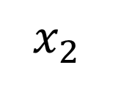
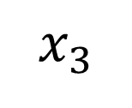
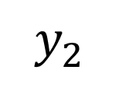
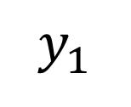
Multi-Sensor Processing System
$$x_{1}$$
MIMO
System
$$y_{1}$$
$$x_{2}$$
$$y_{2}$$
$$x_{3}$$

Slide 9
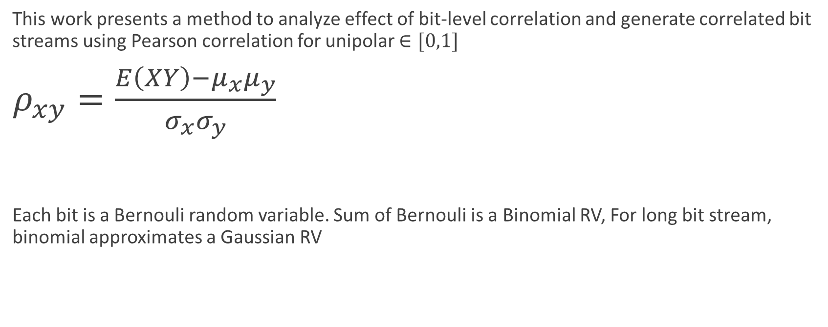
Bit-Level Correlation
This work presents a method to analyze effect of bit-level correlation and generate correlated bit streams using Pearson correlation for unipolar $∈[0,1]$
$ρ_{xy}=\frac{E\left(XY\right)−μ_{x}μ_{y}}{σ_{x}σ_{y}}$
Each bit is a Bernouli random variable. Sum of Bernouli is a Binomial RV, For long bit stream, binomial approximates a Gaussian RV

Slide 10
Outline
Introduction
Previous Work
Objective
Theoretical Results
Simulated Results
Conclusions and Future Work

Slide 11
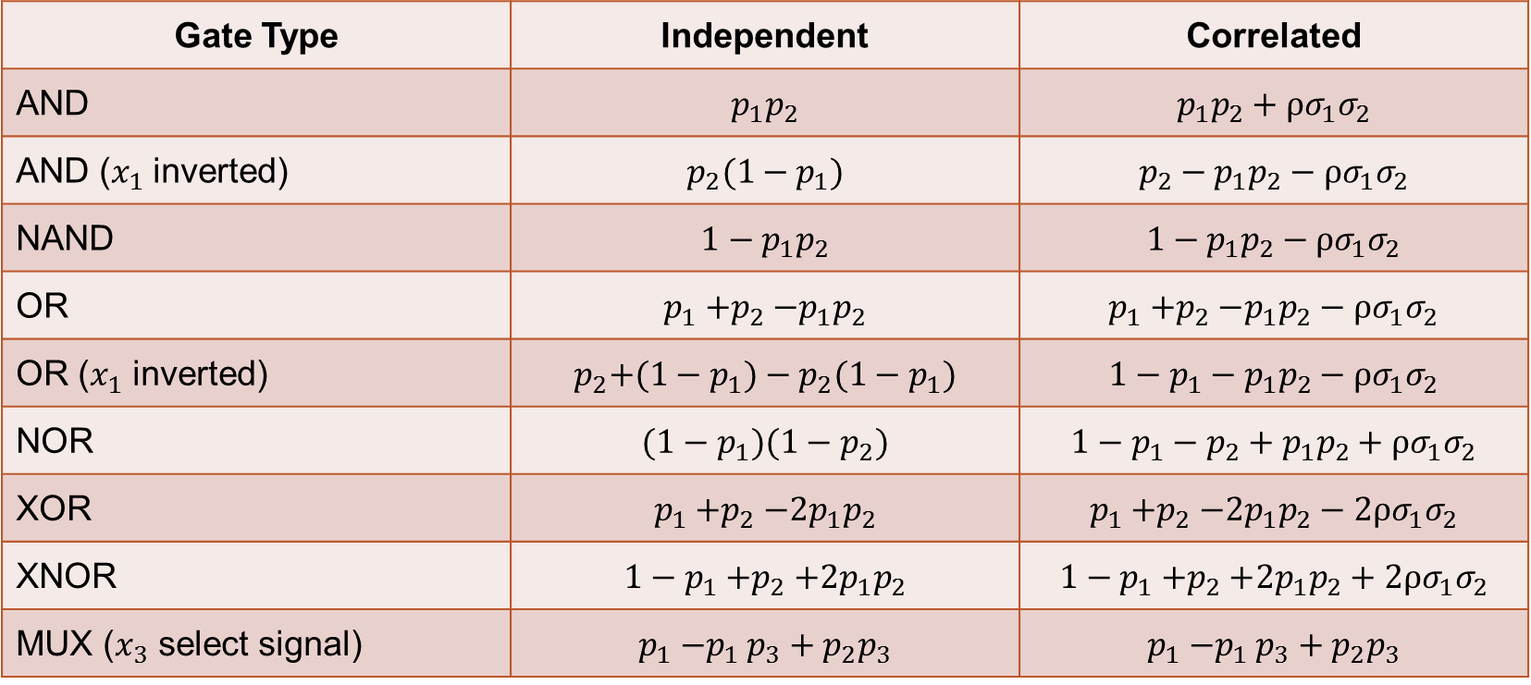
Closed Form Expressions for Single Logic Gates
Gate Type | Independent | Correlated
AND | $$p_{1}p_{2}$$ | $$p_{1}p_{2}+ρσ_{1}σ_{2}$$
AND ($x_{1}$ inverted) | $p_{2}{(1−p}_{1})$ | $${p_{2}−p}_{1}p_{2}−ρσ_{1}σ_{2}$$
NAND | $${1−p}_{1}p_{2}$$ | $${1−p}_{1}p_{2}−ρσ_{1}σ_{2}$$
OR | $$p_{1}{+p}_{2}−p_{1}p_{2}$$ | $$p_{1}{+p}_{2}−p_{1}p_{2}−ρσ_{1}σ_{2}$$
OR ($x_{1}$ inverted) | $$p_{2}{+(1−p}_{1})−p_{2}(1−p_{1})$$ | $${1−p_{1}−p}_{1}p_{2}−ρσ_{1}σ_{2}$$
NOR | $${(1−p}_{1})(1−p_{2})$$ | $${1−p}_{1}−p_{2}+p_{1}p_{2}+ρσ_{1}σ_{2}$$
XOR | $$p_{1}{+p}_{2}−2p_{1}p_{2}$$ | $$p_{1}{+p}_{2}−2p_{1}p_{2}−2ρσ_{1}σ_{2}$$
XNOR | $${1−p}_{1}{+p}_{2}+2p_{1}p_{2}$$ | $${1−p}_{1}{+p}_{2}+2p_{1}p_{2}+2ρσ_{1}σ_{2}$$
MUX ($x_{3}$ select signal) | $$p_{1}{−p}_{1}p_{3}+p_{2}p_{3}$$ | $$p_{1}{−p}_{1}p_{3}+p_{2}p_{3}$$

Slide 12
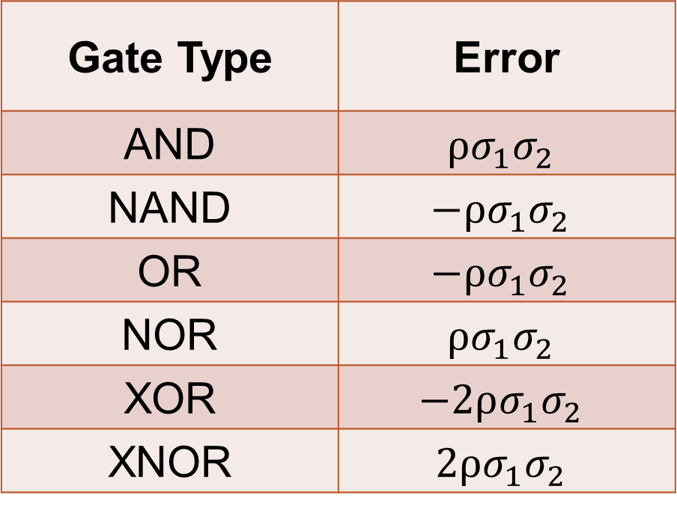

Error Analysis $E\left(Deviation\right)=Error)$
Gate Type | Error
AND | $$ρσ_{1}σ_{2}$$
NAND | $$−ρσ_{1}σ_{2}$$
OR | $$−ρσ_{1}σ_{2}$$
NOR | $$ρσ_{1}σ_{2}$$
XOR | $$−2ρσ_{1}σ_{2}$$
XNOR | $$2ρσ_{1}σ_{2}$$

Slide 13
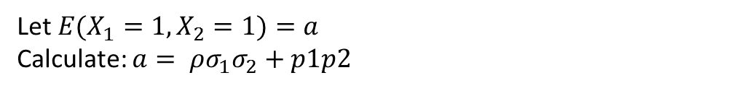
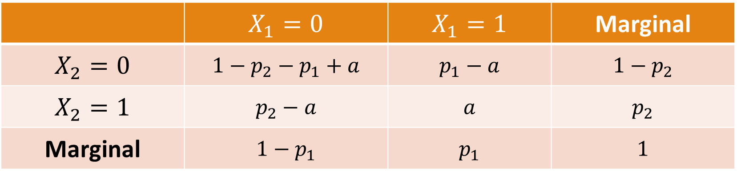
Synthesis Correlated Bit Streams from Uncorrelated Bit Streams (Unipolar)
 | $$X_{1}=0$$ | $$X_{1}=1$$ | Marginal
$$X_{2}=0$$ | $$1−p_{2}−p_{1}+a$$ | $$p_{1}−a$$ | $$1−p_{2}$$
$$X_{2}=1$$ | $$p_{2}−a$$ | $$a$$ | $$p_{2}$$
Marginal | $$1−p_{1}$$ | $$p_{1}$$ | $$1$$
Let $E(X_{1}=1,X_{2}=1)=a$
Calculate: $a= ρσ_{1}σ_{2}+p1p2$

Slide 14
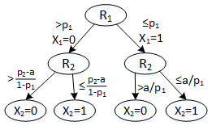
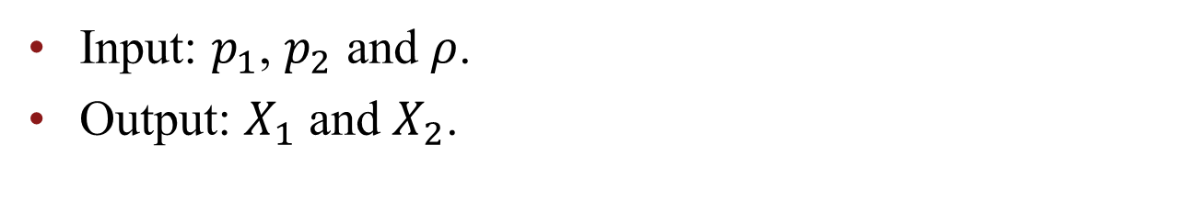
Synthesis of Two Correlated Stochastic Bit Streams
Input: $p_{1}$, $p_{2}$ and $ρ$.
Output: $X_{1}$ and $X_{2}$.

Slide 15
Synthesized Circuit using LFSR, MUX

Slide 16
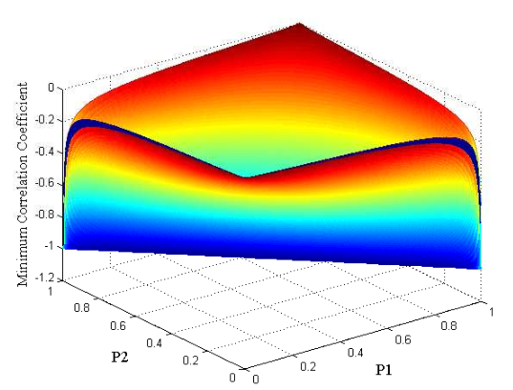
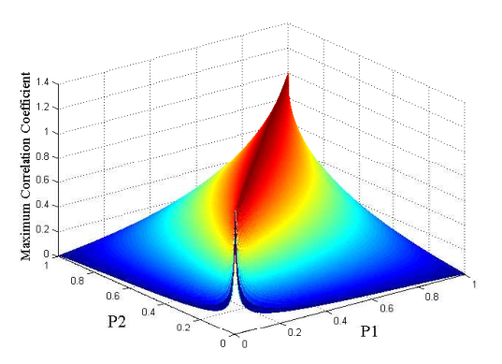
Range
Minimum Correlation Coefficient
Maximum Correlation Coefficient

Slide 17


Constraints for Correlation $ρ$
$\left\{\begin{aligned}ρ≥max⁡(\frac{−p1p2}{σ1σ2}, \frac{−p1p2+p1+p2−1}{σ1σ2}) \\ ρ≤min⁡(\frac{p1−p1p2}{σ1σ2},\frac{p2−p1p2}{σ1σ2}) \end{aligned}\right\}$

Slide 18
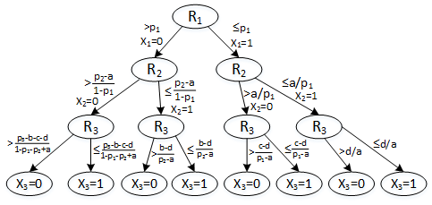
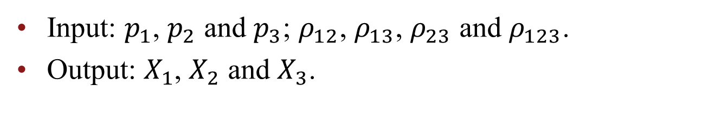
Synthesis of Three Correlated Stochastic Bit Streams
Input: $p_{1}$, $p_{2}$ and $p_{3}$; $ρ_{12}$, $ρ_{13}$, $ρ_{23}$ and $ρ_{123}$.
Output: $X_{1}$, $X_{2}$ and $X_{3}$.

Slide 19
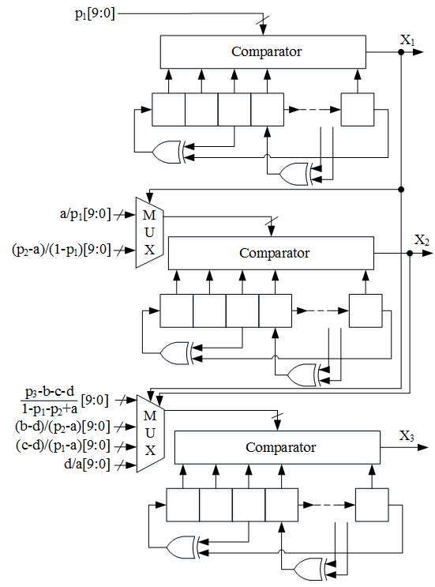
Circuit Diagram of Synthesized Circuit

Slide 20
Outline
Introduction
Previous Work
Objective
Theoretical Results
Simulated Results
Conclusions and Future Work

Slide 21
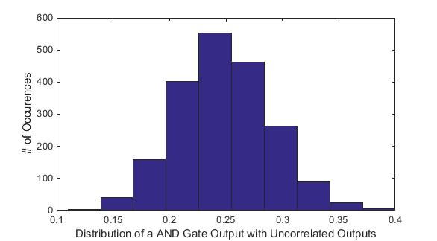
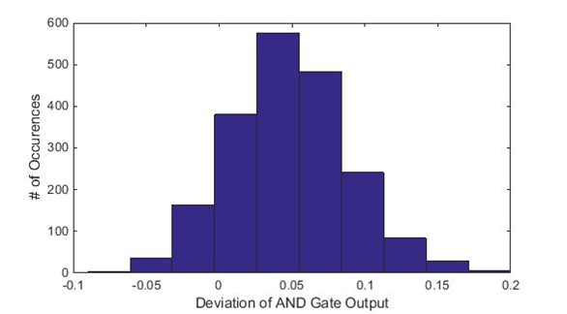

Simulated Results
$ρ=0.2$
$\hat{y}=p_{1}p_{2}+ρσ_{1}σ_{2}$
$$=0.2+0.2\frac{\sqrt{0.4×0.5×0.5×0.6}}{100}=0.2489 \\ E\left(Deviation\right)=Error=\hat{y}−y=0.2489−0.2=0.0489$$

Slide 22
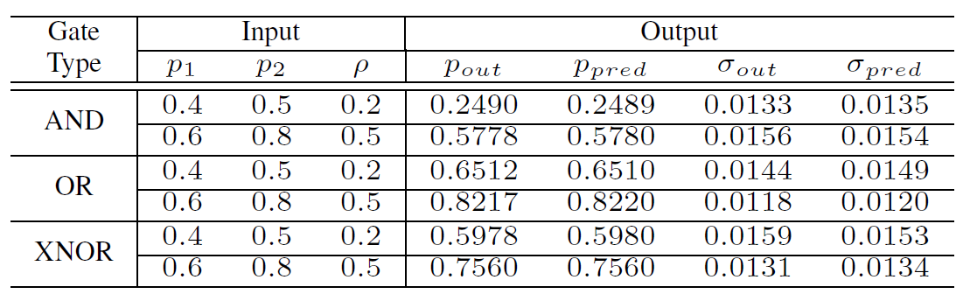
Simulation Results of Stochastic Logic Given Correlated inputs

Slide 23
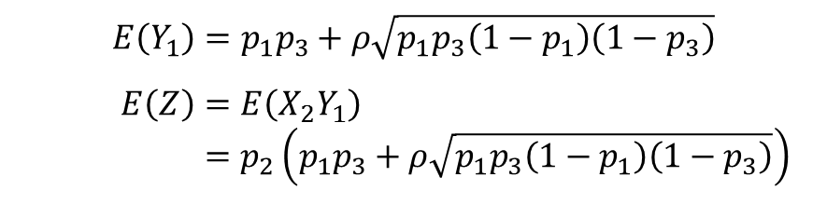
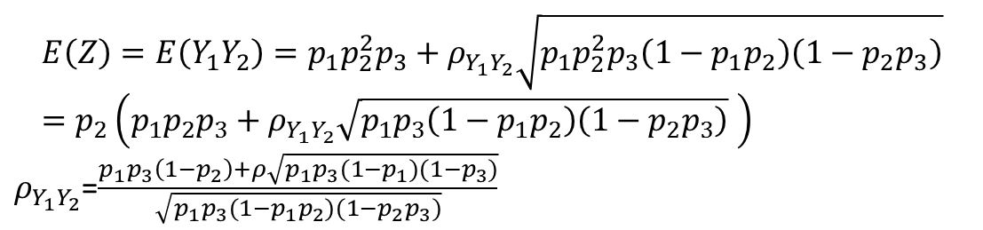
Example using Logic Gates
$$E\left(Z\right)=E\left(Y_{1}Y_{2}\right)=p_{1}p_{2}^{2}p_{3}+ρ_{Y_{1}Y_{2}}\sqrt{p_{1}p_{2}^{2}p_{3}\left(1−p_{1}p_{2}\right)\left(1−p_{2}p_{3}\right)}=p_{2}\left(p_{1}p_{2}p_{3}+ρ_{Y_{1}Y_{2}}\sqrt{p_{1}p_{3}\left(1−p_{1}p_{2}\right)\left(1−p_{2}p_{3}\right)} \right)$$
$ρ_{Y_{1}Y_{2}}$=$\frac{p_{1}p_{3}\left(1−p_{2}\right)+ρ\sqrt{p_{1}p_{3}(1−p_{1})(1−p_{3})}}{\sqrt{p_{1}p_{3}(1−p_{1}p_{2})(1−p_{2}p_{3})}}$
$$E\left(Y_{1}\right)=p_{1}p_{3}+ρ\sqrt{p_{1}p_{3}\left(1−p_{1}\right)\left(1−p_{3}\right)}$$
$$E\left(Z\right)=E\left(X_{2}Y_{1}\right) \\ =p_{2}\left(p_{1}p_{3}+ρ\sqrt{p_{1}p_{3}\left(1−p_{1}\right)\left(1−p_{3}\right)}\right)$$

Slide 24
Conclusion
Presented an approach to analyze effect of bit-level correlation
Presented synthesis of correlated bit streams
Simulation results confirm results predicted from theory

