Slide 1
Wildlife and Water Quality Landscaping
Prepared for Silver Lake Association
Dorothy Pedersen
Nature’s Garden LLC

Slide 2
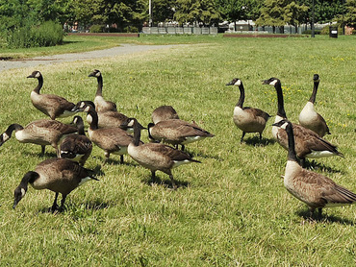
Hazing, bird scare tape, dogs. . .

Slide 3
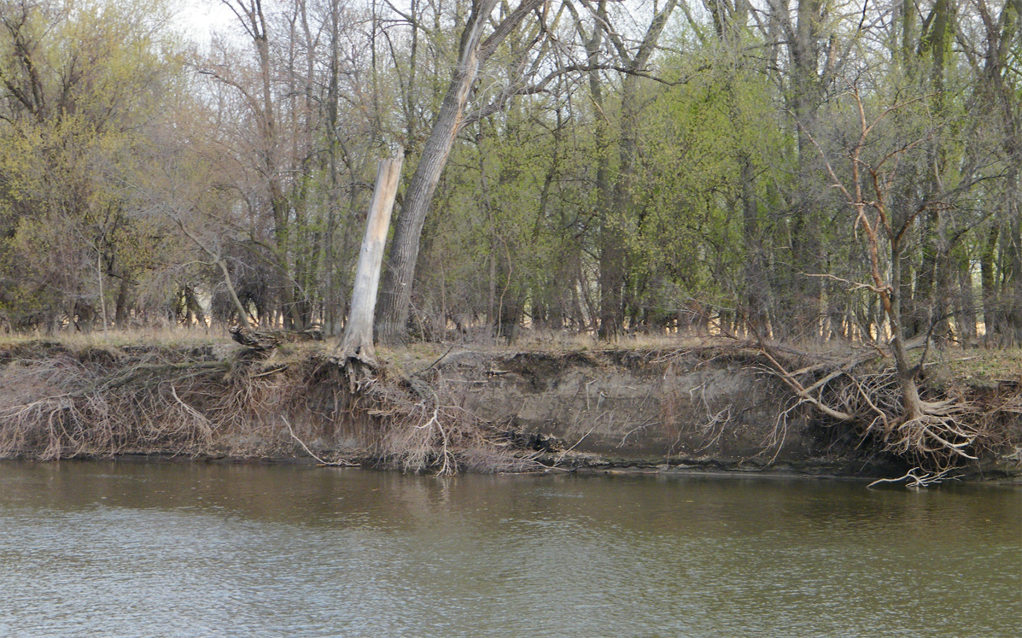
Shoreline Erosion

Slide 4
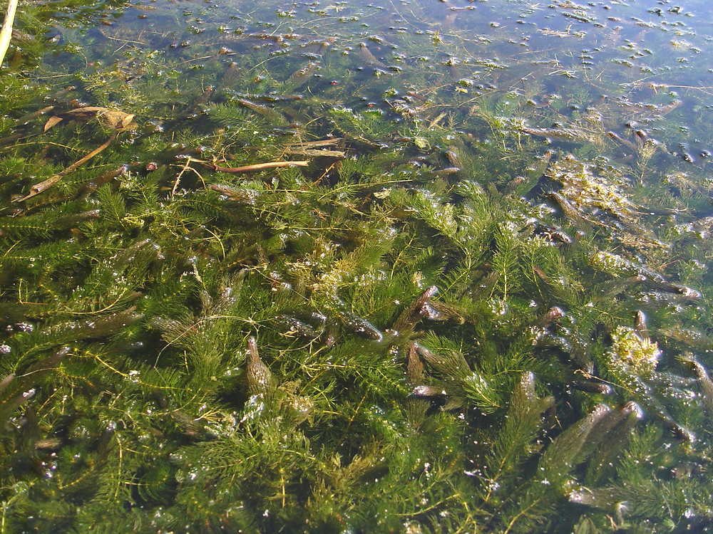
Excessive Coontail Growth

Slide 5
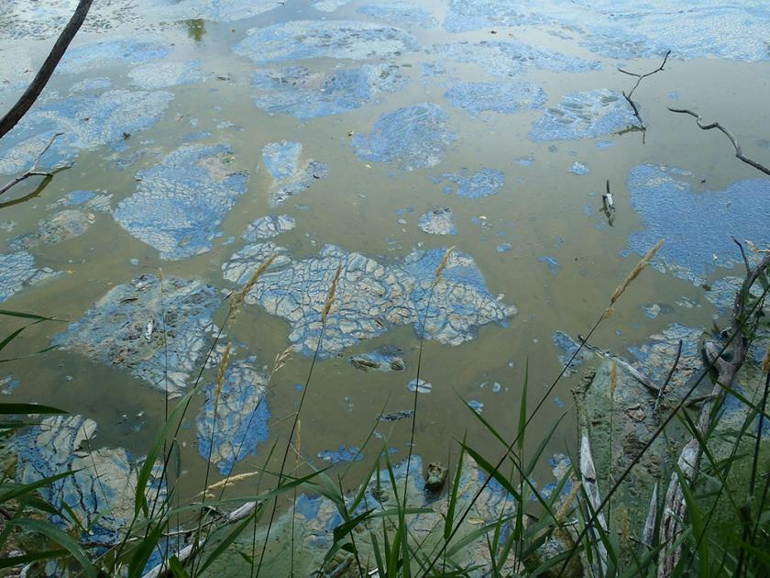
Blue Green Algae

Slide 6
What we want:
Clean Water
Beautiful Views
Wildlife
All of thee create: Enjoyment of the lake!

Slide 7
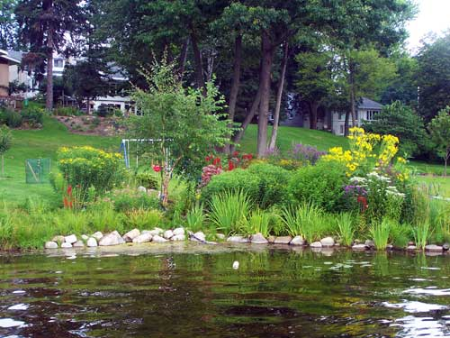
The Answer! Shoreline Buffers

Slide 8
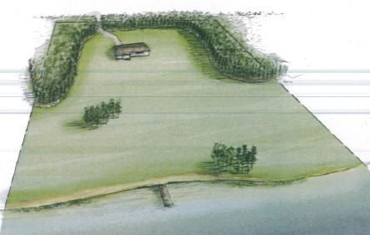
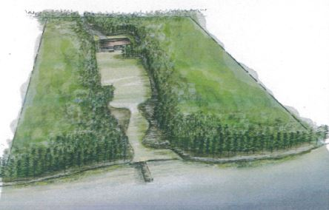
Current Landscaping
Recommended Landscaping

Slide 9
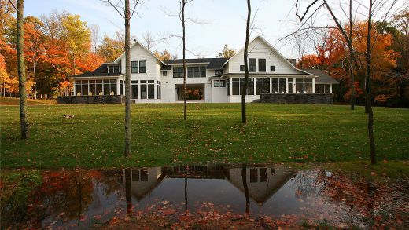

Slide 10
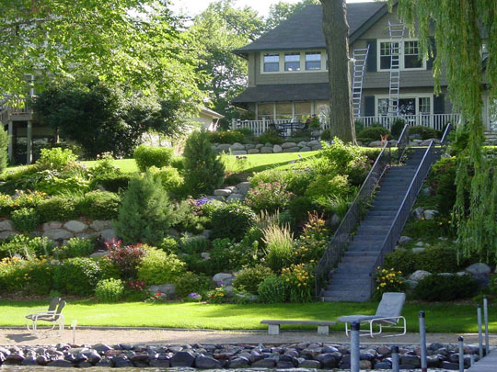
Re-landscape or leave with native plants

Slide 11
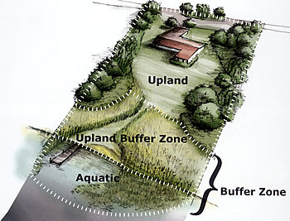
How to do it?

Slide 12
Rules of Thumb
1. Respect the Regs
2. Stabilize the Shoreline
Retain and Filter Runoff
During and after install
Manage your turf
Use Herbicides only when necessary
Design with habitat for wildlife, bees, birds and butterflies
Maintenance is Key!
Eliminate invasives

Slide 13
Regulations
Check with your City: Chanhassen, Minnetonka, Shorewood
Check with RPBCWD
DNR

Slide 14
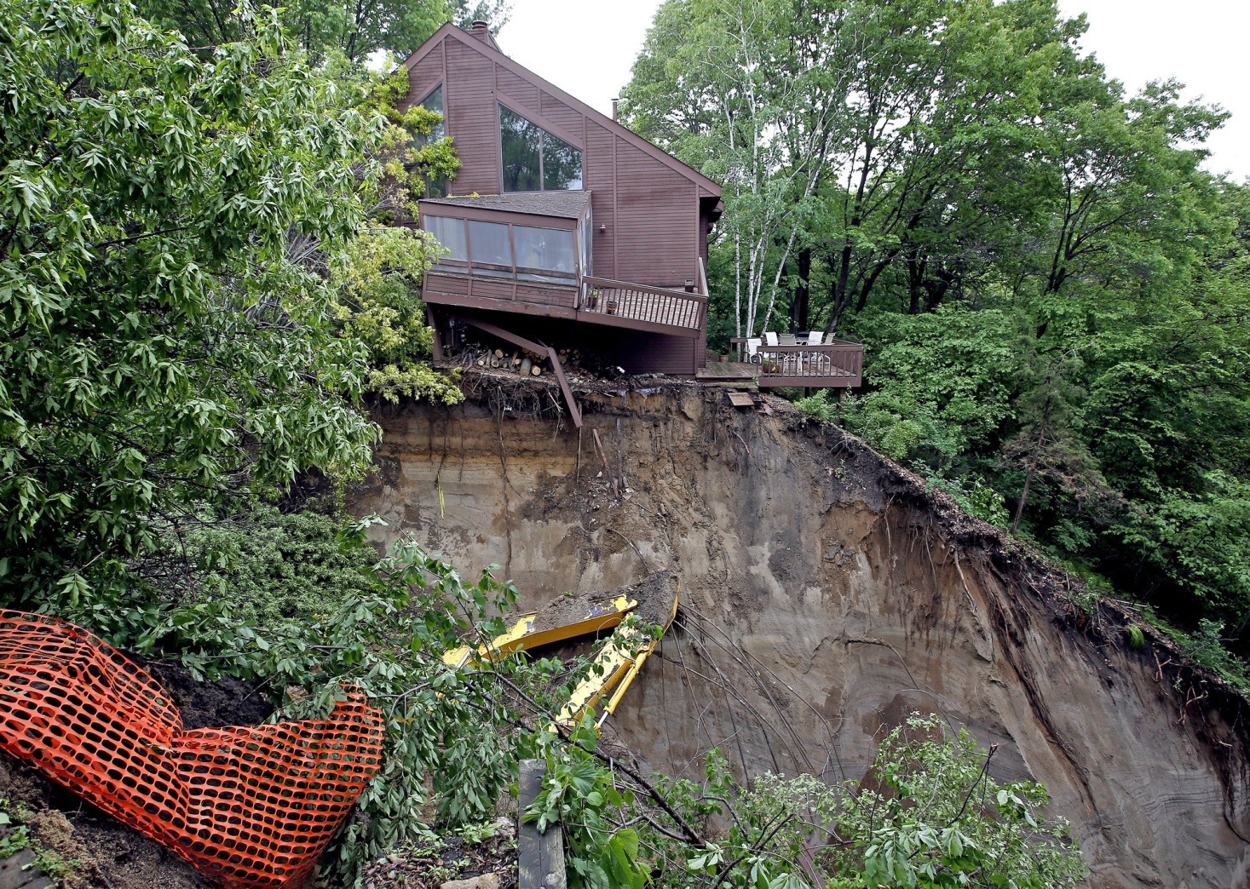
Slope collapse

Slide 15
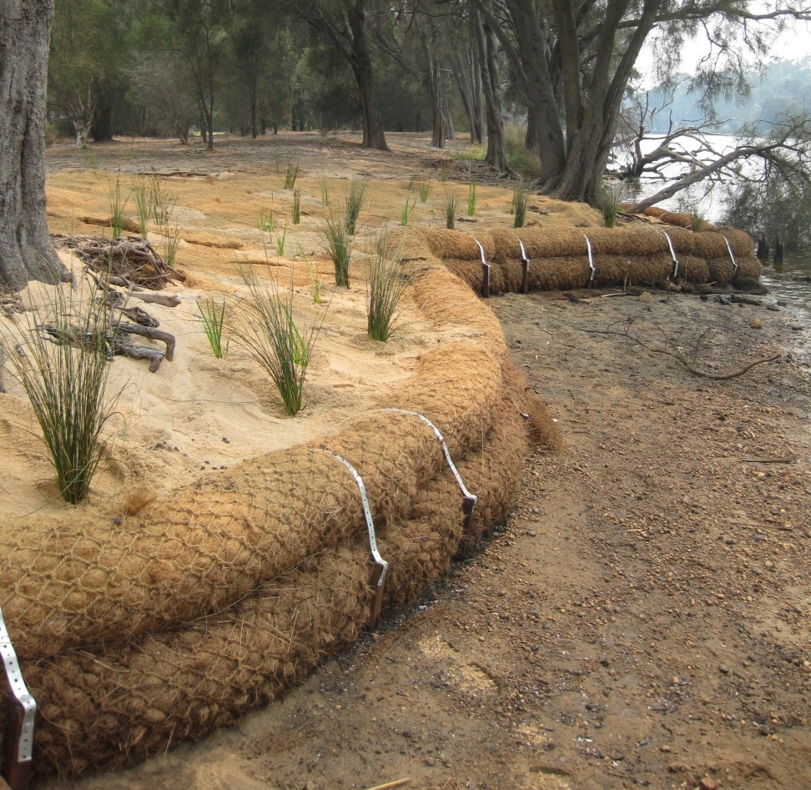
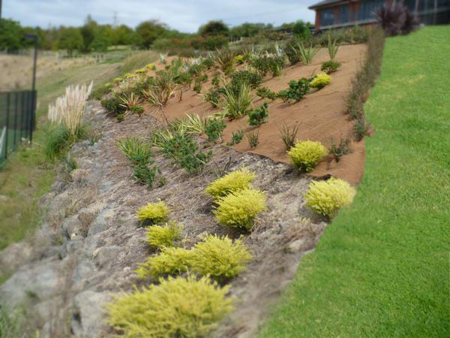
Fabric and Soil Coir

Slide 16
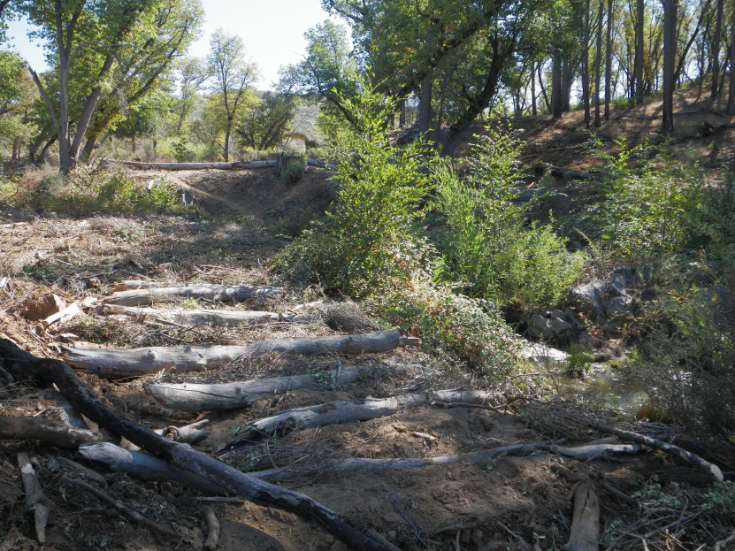
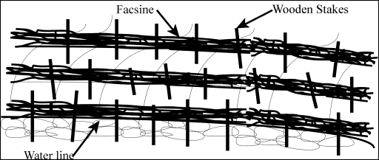
Re-use logs/brush

Slide 17
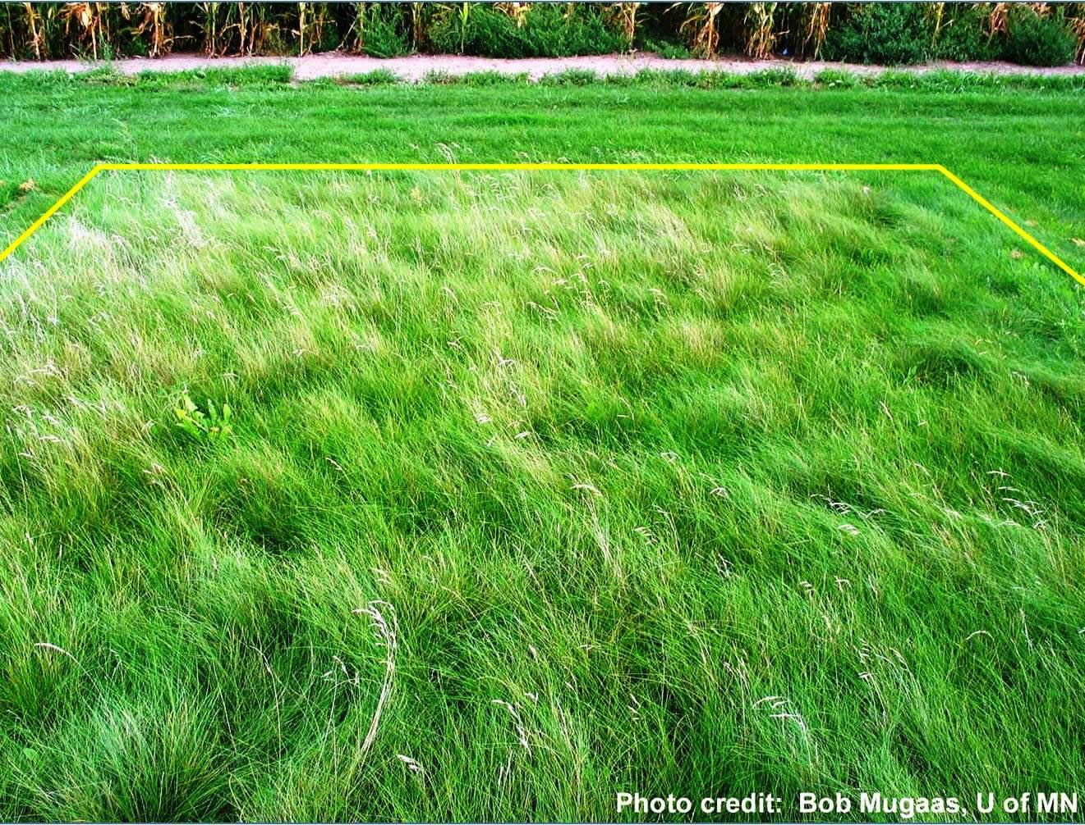
Turf Management
1. Reduce the amount of turf;
2. No fertilizer within 20’ of shoreline
3. Set your mower deck to 3” high
4. Convert your lawn to Low Grow No Mow grass

Slide 18
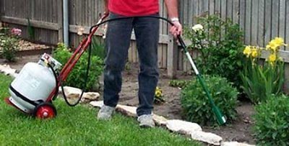
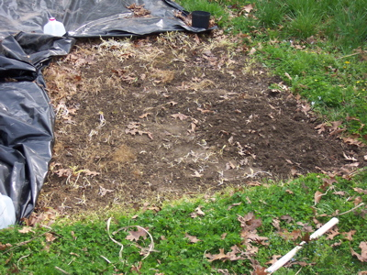
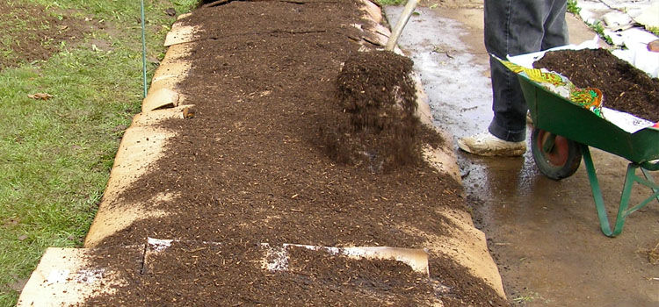
Herbicide use
Only when necessary
Try the Weed Dragon
Black Plastic
Cardboard and double shredded hardwood

Slide 19
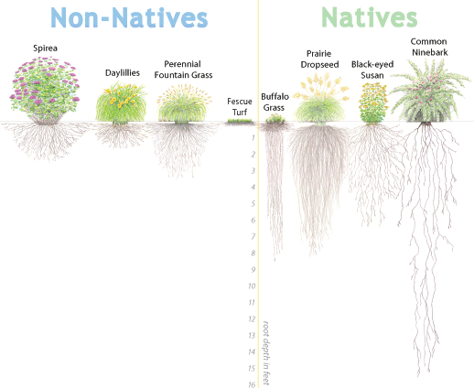
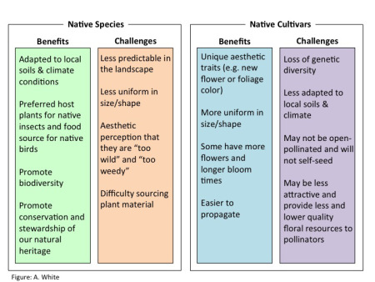
Design
Native have longer roots, and usually better food for bees, butterflies and birds.
Nativars (a cultivar of a native plant) sometimes are a better choice
Plant to fit your design aesthetics

Slide 20
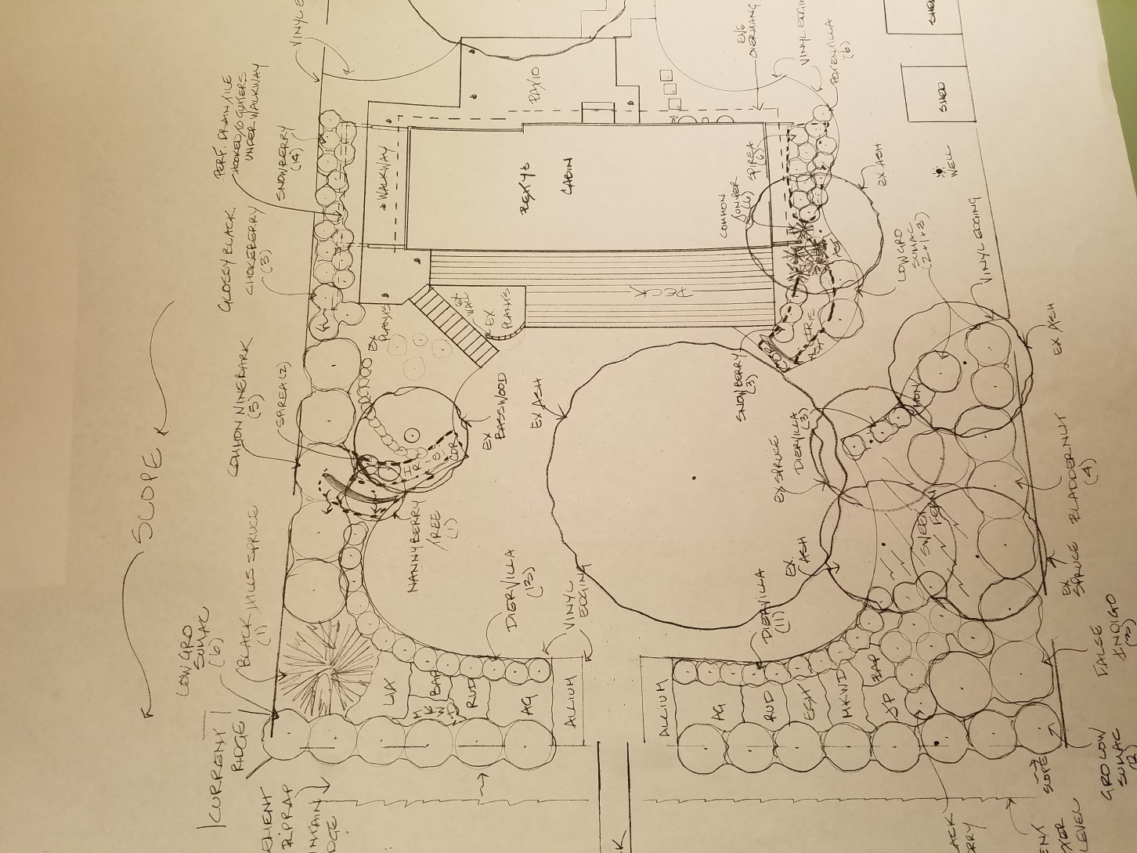
Plan your buffer

Slide 21
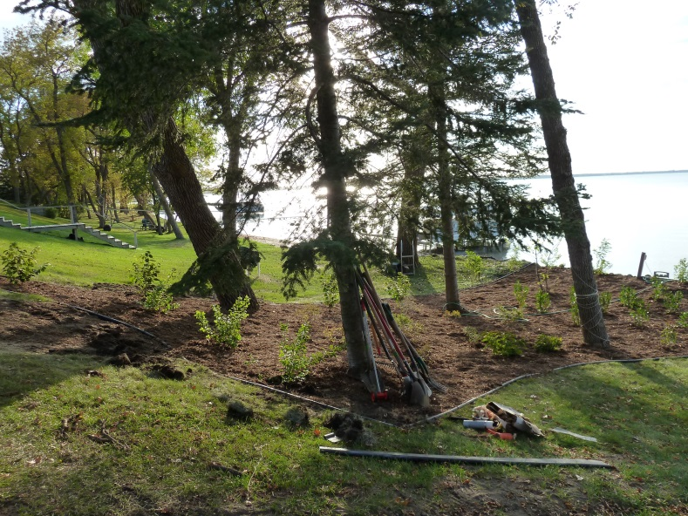
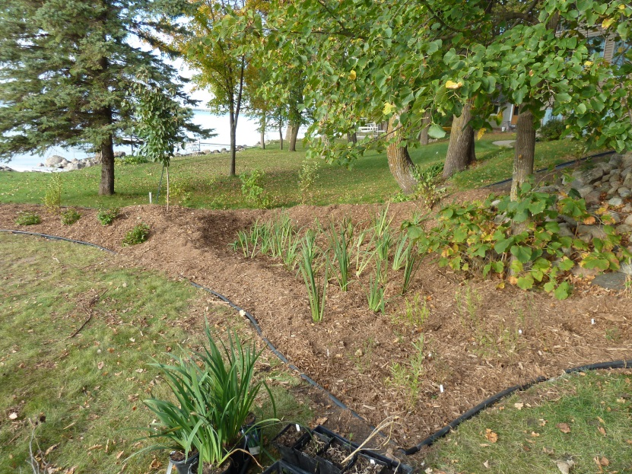
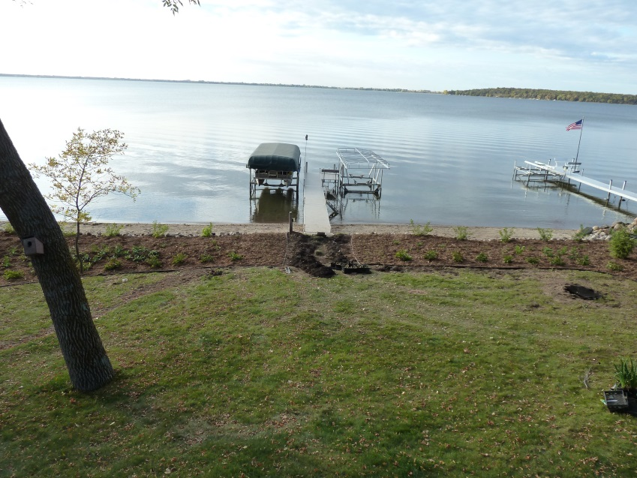
Plant Your Buffer

Slide 22
Seasonal Maintenance
1. But back your perennials prior to new spring growth
2. Pull weeds before Memorial Day (cool season weeds)
3. Pull Weeds before the Fourth of July (warm season weeds)
4. Water your plants as needed
5. Pull weeds around Labor Day

Slide 23
Resources
Landscaping for Wildlife and Water Quality
MN DNR website or book
http://www.dnr.state.mn.us/rys/index.html
The Lake Minnetonka Guide to Shoreline Gardens
Blue Thumb.org
Riley Purgatory Bluff Creed Watershed

Slide 24
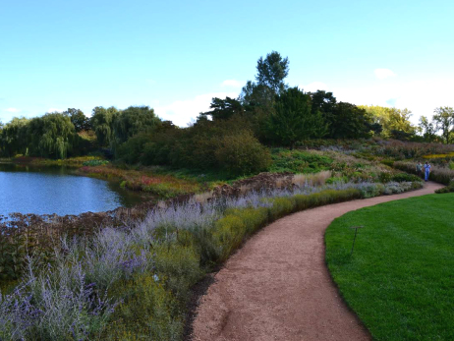
Shoreline buffer strip at maturity

