Slide 1
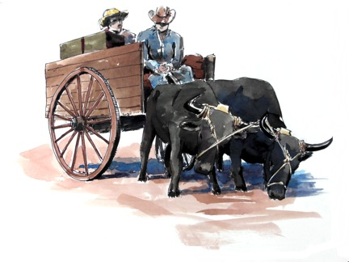
A Mini History
Silver Lake’s First Settlers

Slide 2


Silver Lake was previously known by a different name. What was it?
Swede Lake
Silvine Lake
Lake McGrath
German Lake
Bde Maka Ska
Ridge Lake

Slide 3
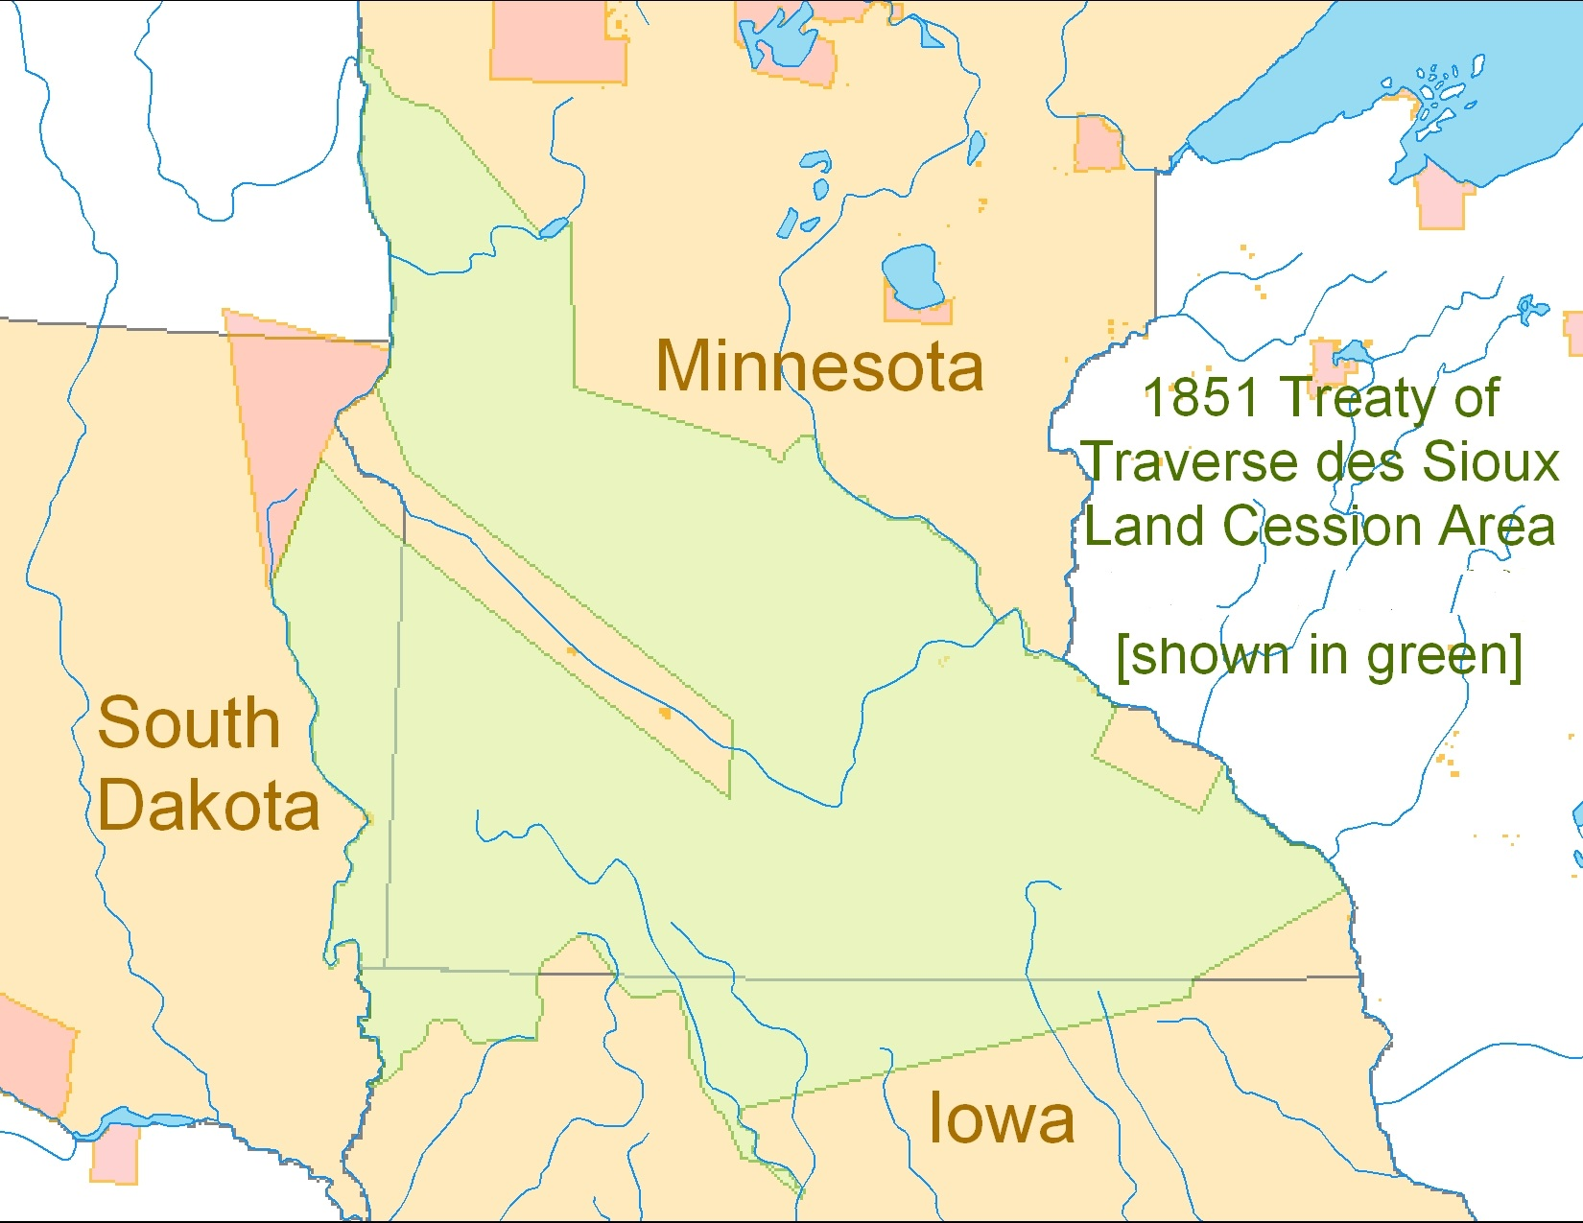

Slide 4
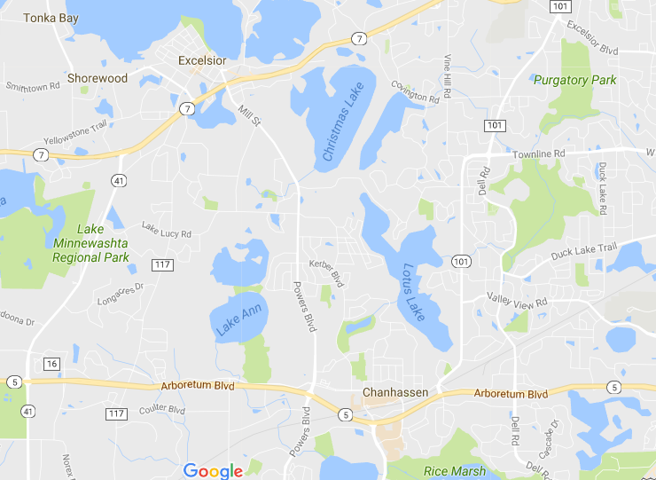
First Settlers Spring 1853
Organized settlement colonies
Formal name, by-laws, dues
Advance agents select land claims
Handle legal requirements
Colony cooperatively builds homes, schools, churches

Slide 5
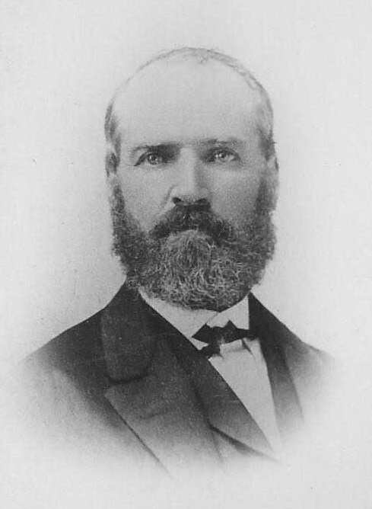
Excelsior Pioneer Association
(New York City)
George Bertram

Slide 6
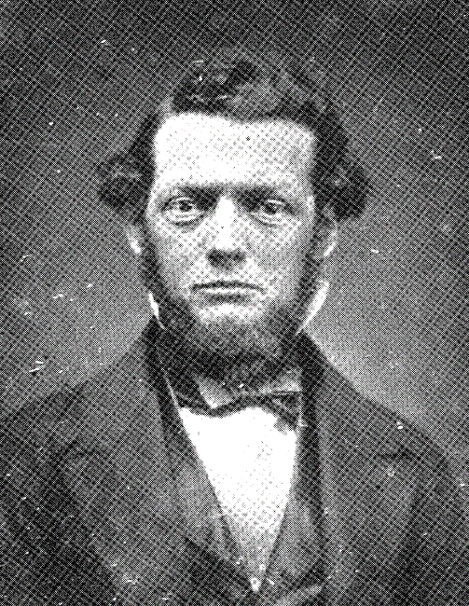
Minnesota Claim Association Northampton Colony
(Massachusetts)
Reverend
Henry Martyn Nichols

Slide 7
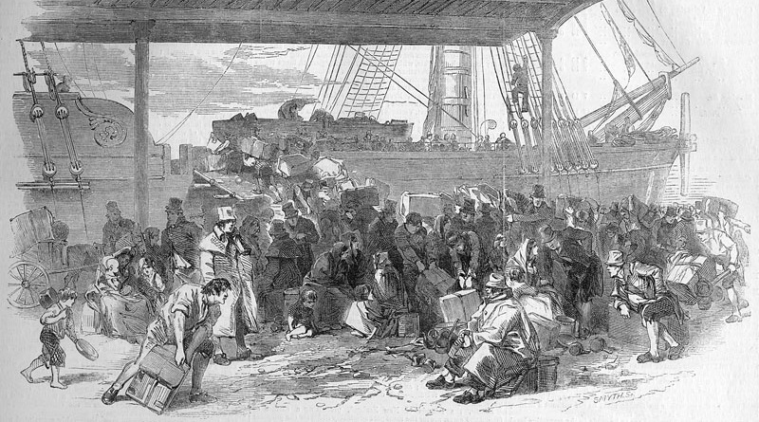
Next Wave Settlers
Starting 1853/54
German Catholic Immigrants

Slide 8
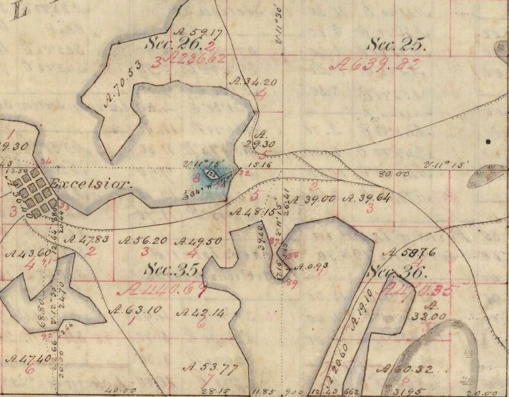
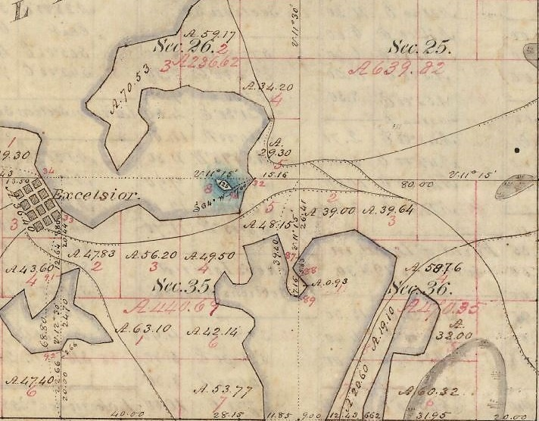
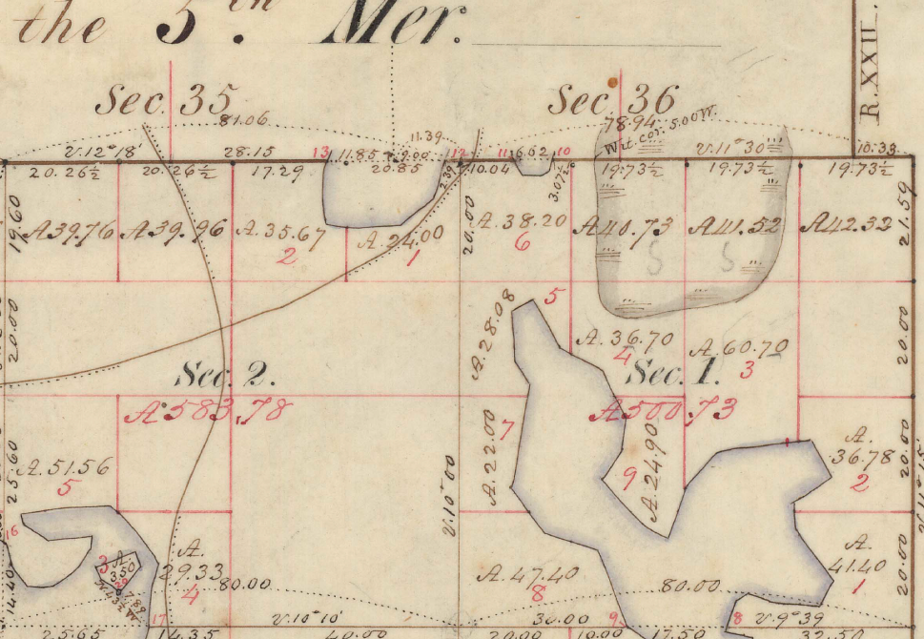
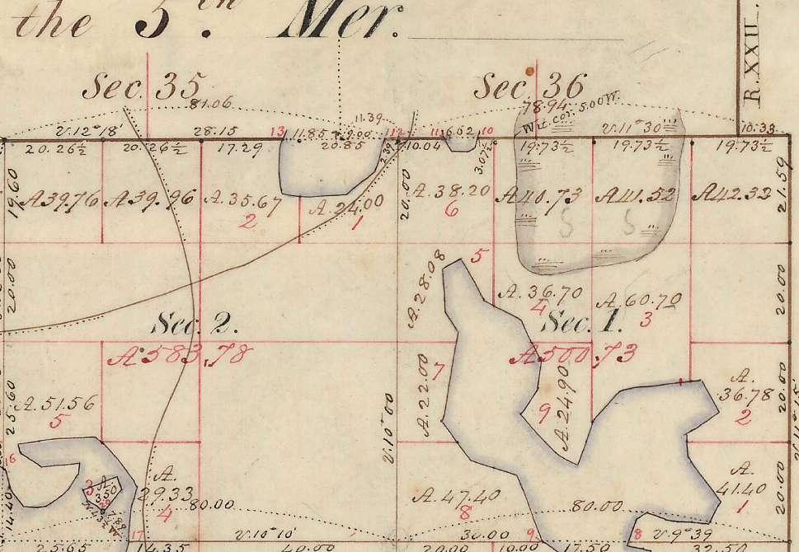
First Survey Map 1854
Indian trail to Minnetonka Mills and St. Anthony
Wetland
To Chief Shakopee’s village

Slide 9
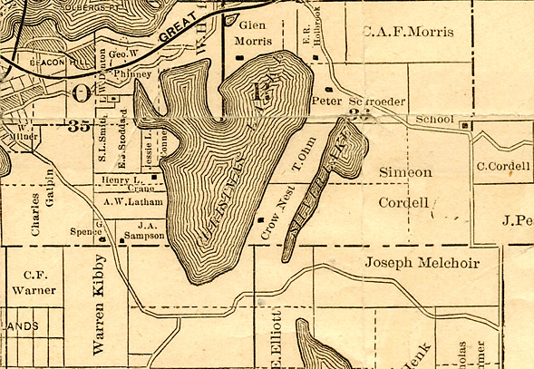
Covington
Purgatory Springs School
Vine Hill
Powers Blvd.
101
Pleasantview

Slide 10
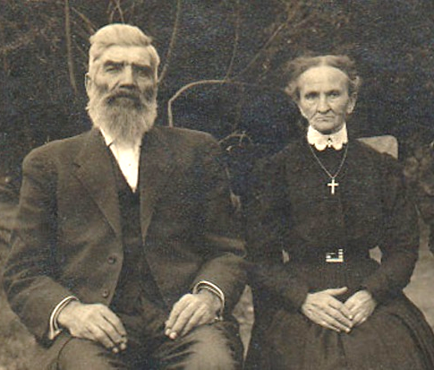


Simon and Katharina (Lehnertz) Cordell

Slide 11
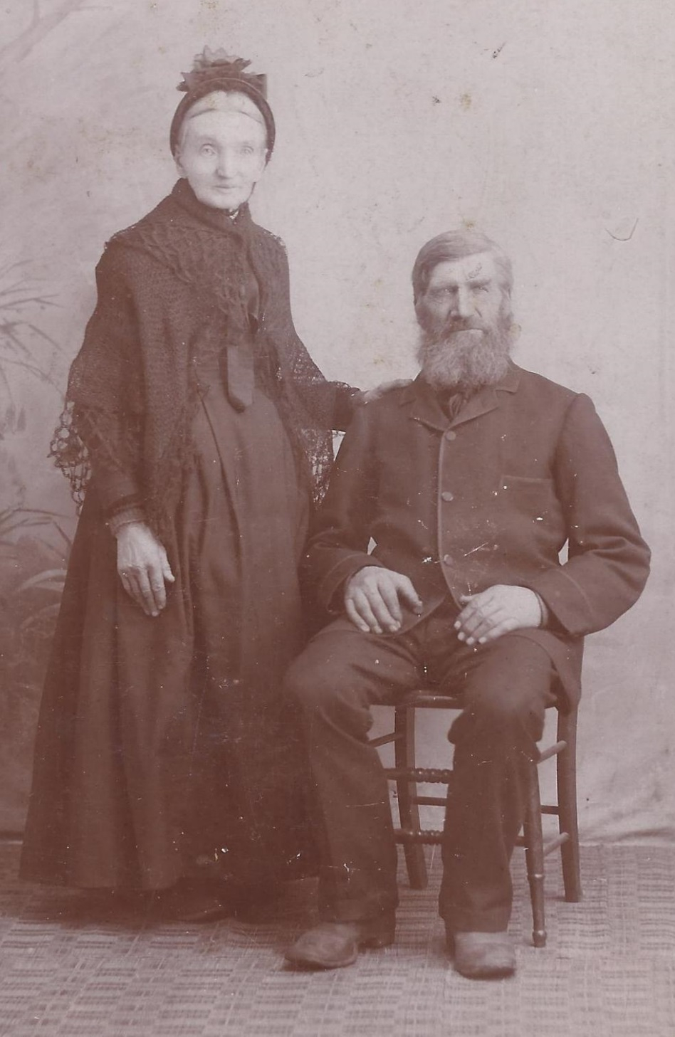
Married in Germany 1846.
Immigrated to America 1852.
Settled on Silver Lake late 1853/1854.
Had 12 children.
Lived on the farm to the end of their days. Passed it down.
Simon dies 1901 - 82 years Katharina dies 1916 – 91 years
Both buried St. Hubert Church

Slide 13
Peter and Elizabeth (Lehnertz) Schroeder
Married in Germany 1839
Elizabeth was younger sister of Katharina Cordell
Followed the Cordells to America and to Silver Lake
Built house at the intersection Covington + Ridge Rd.
Had 8 children
Peter dies 1880 – 71 years Elizabeth dies 1900 – 79 years
Both buried at Saint Hubert Catholic Cemetery

Slide 14
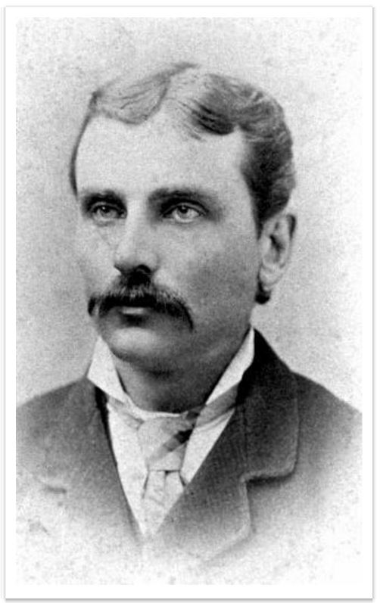
Oldest Schroeder son
Carpenter in Chanhassen
One of the incorporators of the Village of Chanhassen in 1896
First president of city council
Gerhard Schroeder

Slide 15
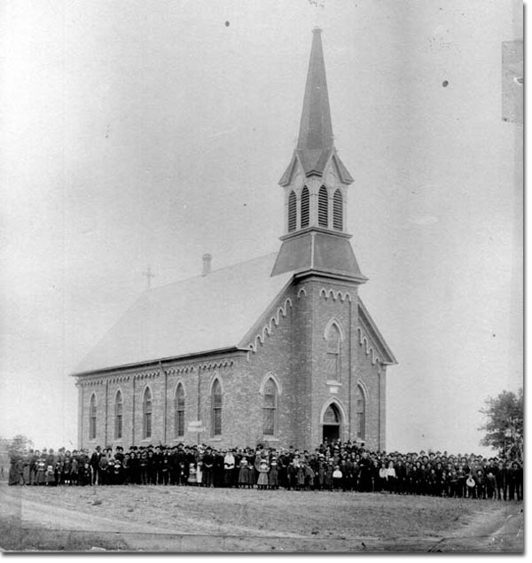
St. Hubert Catholic Church
Chanhassen, MN
Third church building
Built 1887

Slide 17
Thomas and Mary Magdalena (Besler) Ohm
In 1851, bought 158 acres east of Lotus Lake
In 1865, after stint in U.S. Army, sold Lotus Lake farm and moved to Duck Lake
Likely purchased Silver ridge property at same time
Use for Silver ridge ?? – perhaps recreation, investment
Sold in late 1890s to neighbor Edmund Reel

Slide 19
Harry and Beatrice Shuman
Property originally owned by Harry’s maternal grandfather,
Dr. Jacob S. Elliott
Harry’s parents bought the land in 1894 for semi-retirement
Harry graduated in 1894 from Agriculture School – U of M and takes over management of farm
Becomes prolific fruit grower of berries and apples
Marries Beatrice Wallow in 1904 and have two children
Harry dies 1922 @ 50 years; Beatrice moves to Calif.

Slide 20
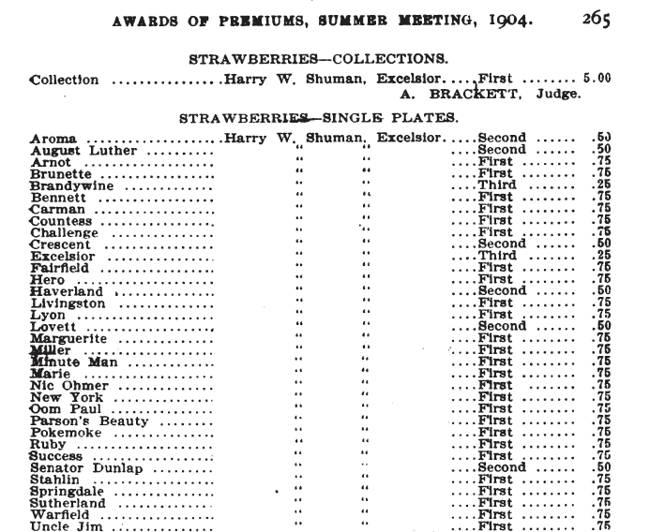
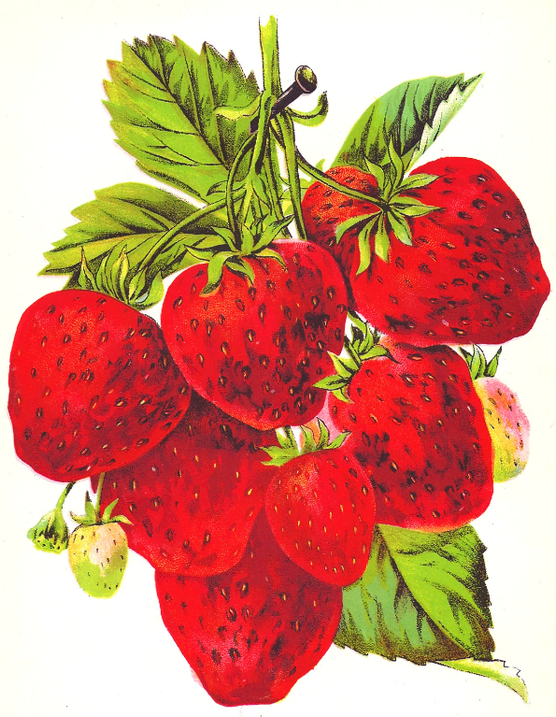
1904 Meeting
Minnesota Horticultural Society
Harry Shuman takes 26
first prizes for strawberries

Slide 21
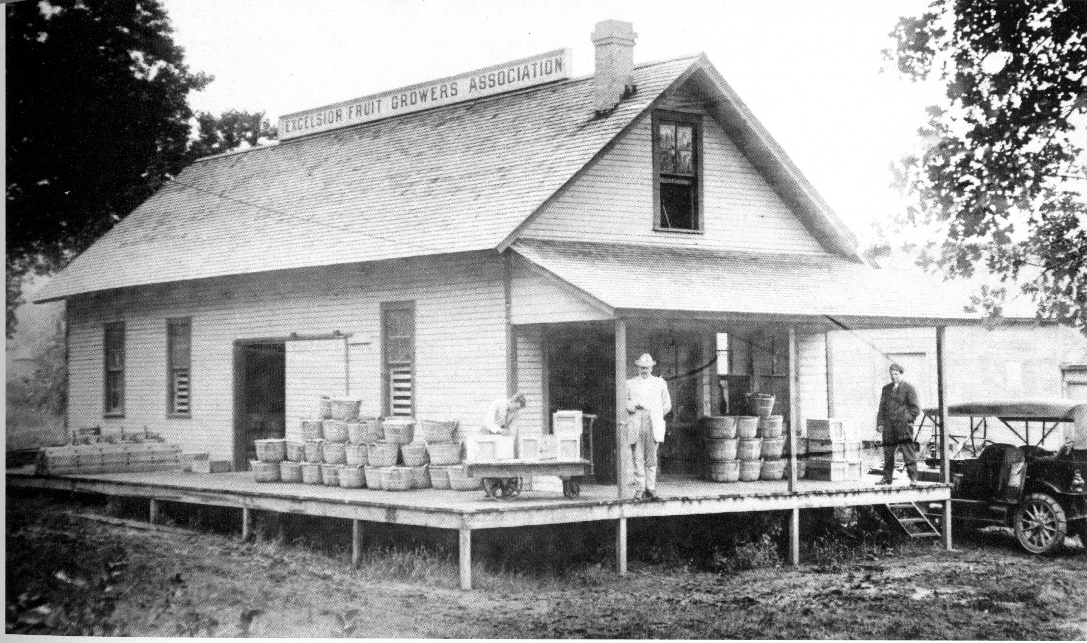
Excelsior Fruit Growers Association
Harry Shuman, and father George, were instrumental in forming the co-op in 1900.
By 1930, serving 450 growers with shipping points in Excelsior, Chanhassen and Hopkins.

Slide 22
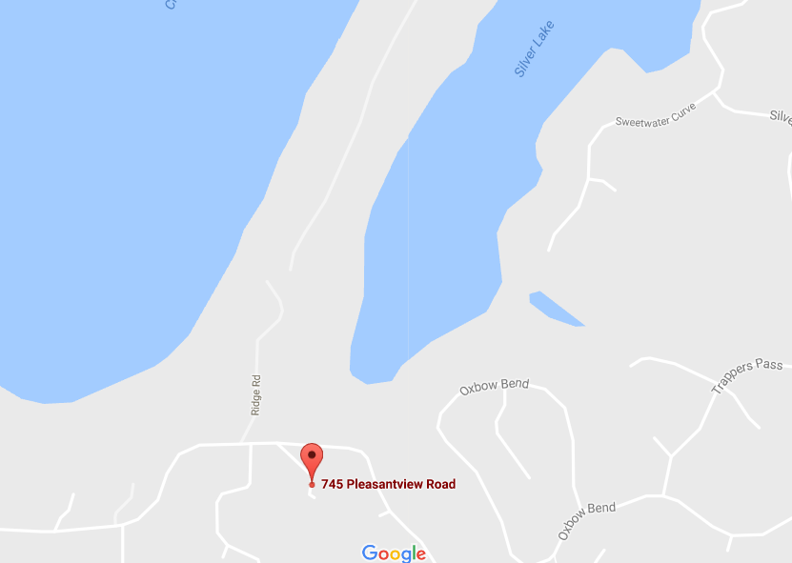
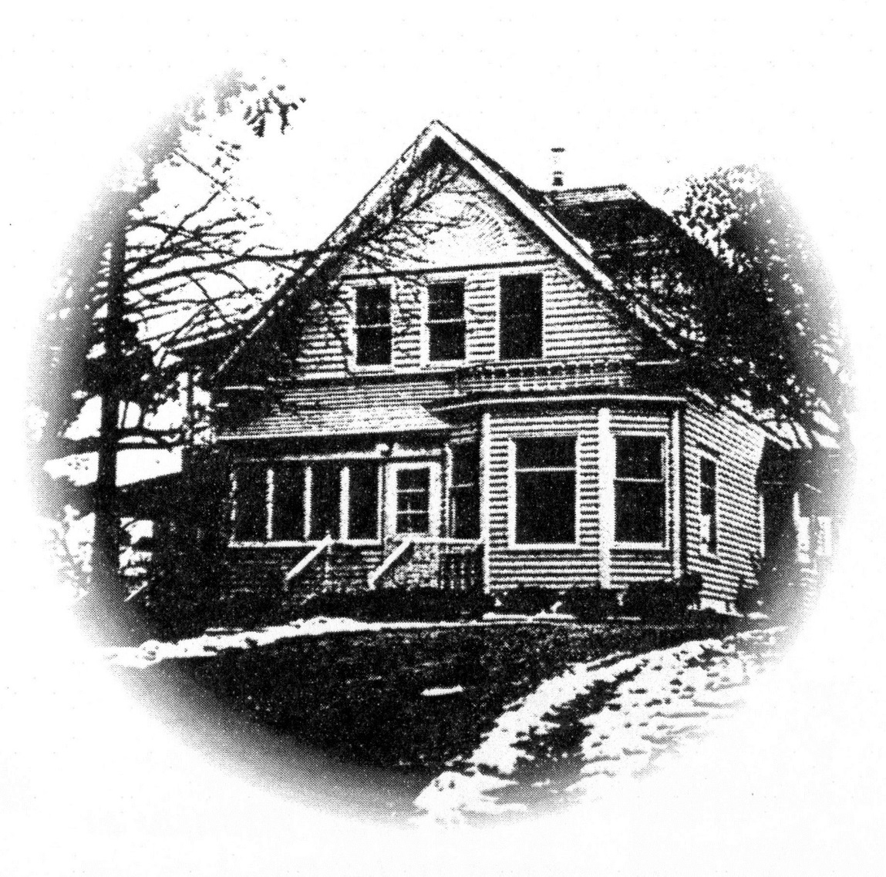
First home in area to have:
Running water - from cistern on Near Mountain
Battery-driven light system
Shuman Home
Circa 1930

Slide 24
Edmund and Elizabeth (Morris) Reel
Edmund Reel was eldest son in family of wealthy farmers from St. Louis
After the Civil War, the family began coming to lake region for summers
Bought 21.6 acres on Silver Lake ridge in 1881
Eventually acquired adjoining land north (from Ohm) and south
Edmund terraced east-facing slope and planted 4000 grape vines; also apple trees at south end

Slide 25
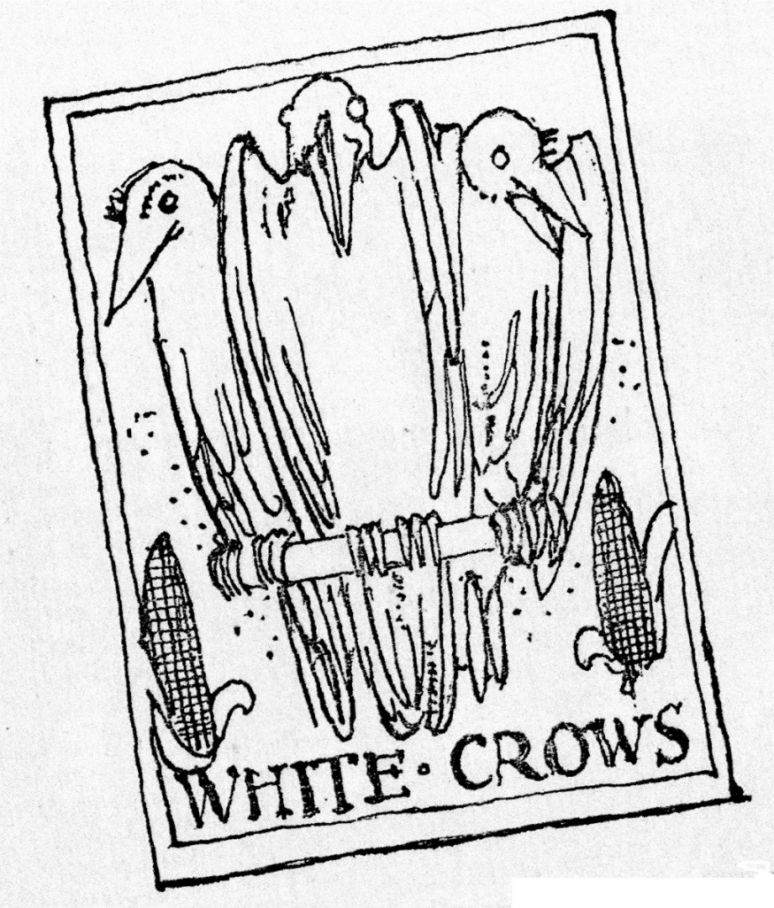
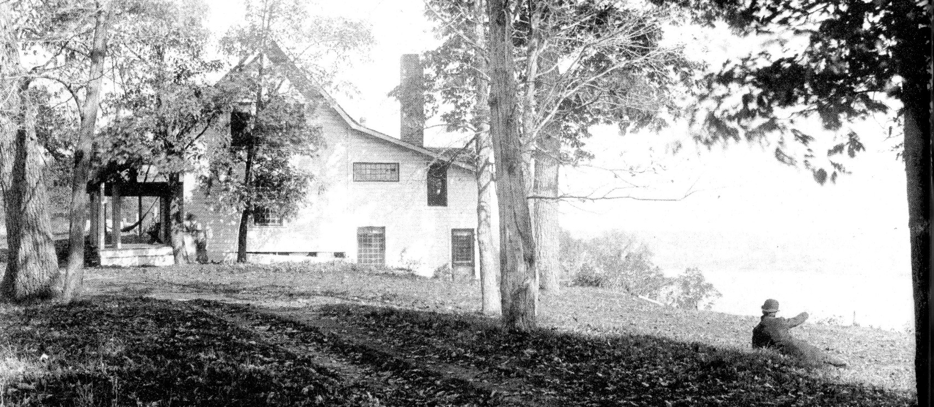
Edmund named his property White Crows Vineyard
Reel Family Cottage on Silver Ridge circa 1893
“Crow’s Nest”

Slide 26
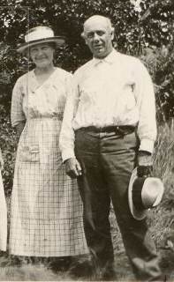
In 1912, Reel sold most of his ridge property to Edwin Hewitt
Hewitt, a Minneapolis architect, sold land parcels to friends and associates
Several summer cottages are eventually built
Reels moved to house on Pleasantview Road
Elizabeth and Edmund Reel

Slide 27
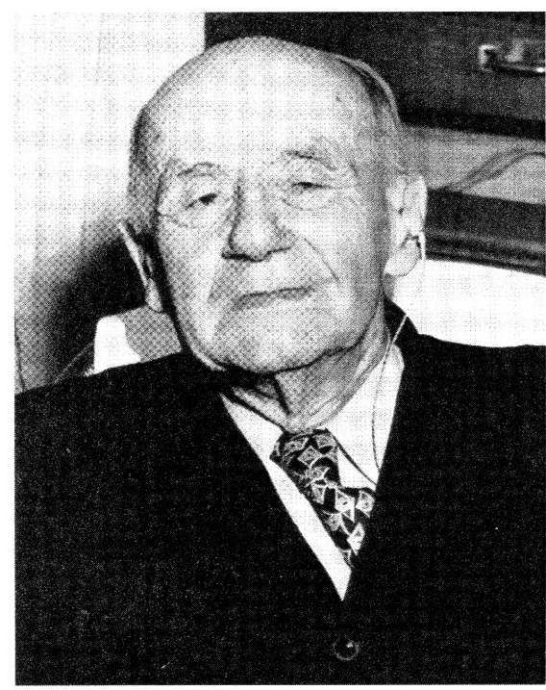
In late years, and nearly blind, Edmund would ride bus into Excelsior
He liked to jawbone with merchants on Water Street
Bragged about selling property to Hewitt @ $1000/acre. Bought for $13/acre.
Elizabeth dies 1944 – 81 years.
Edmund dies 1958 – 97 years.
Both are interred at Lakewood Cemetery in Minneapolis.

Slide 28
Silver Lake was previously known by a different name. What was it?
Swede Lake
Silvine Lake
Lake McGrath
German Lake
Bde Maka Ska
Ridge Lake

