Slide 1

Metropolitan Council Environmental Services
Minnesota Forum on Trenchless Technology
Bloomington, MN
April 20, 2011

Slide 2
Spot Repair of 12” RCP using
Link-pipe® Sewer Sealer™
Shorewood, MN
March 4, 2011

Slide 3
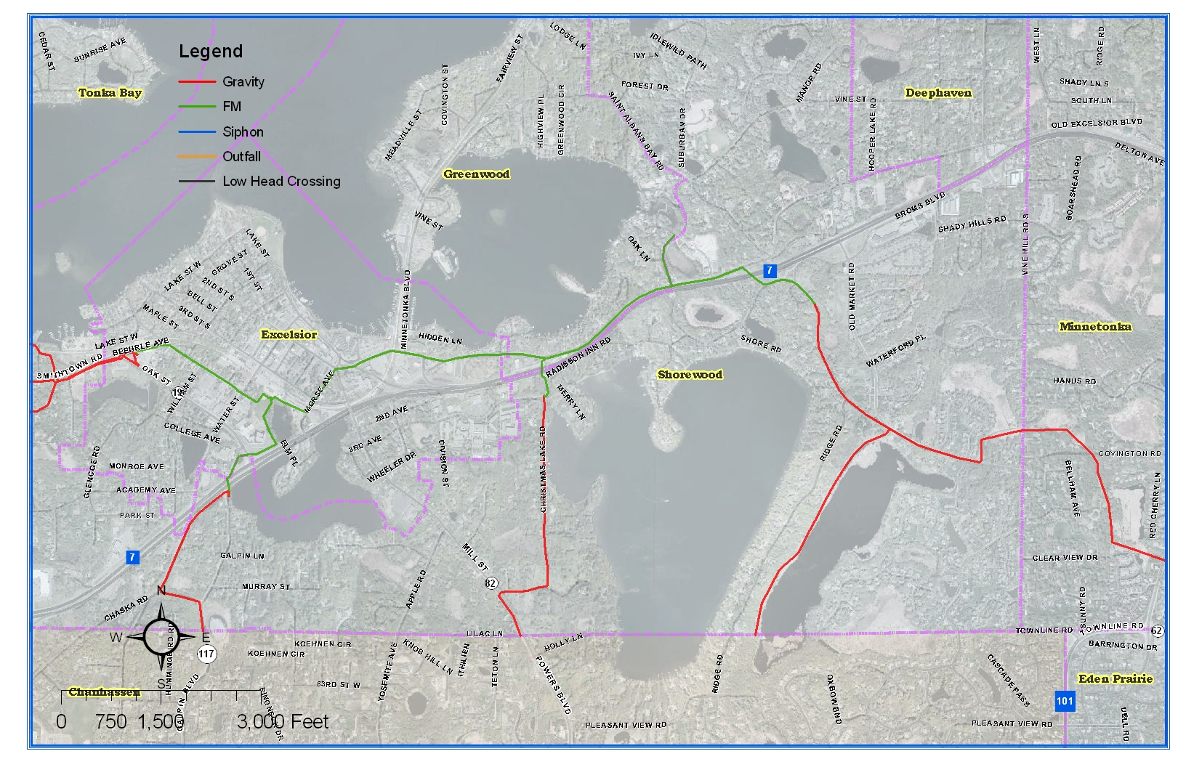
Location

Slide 4
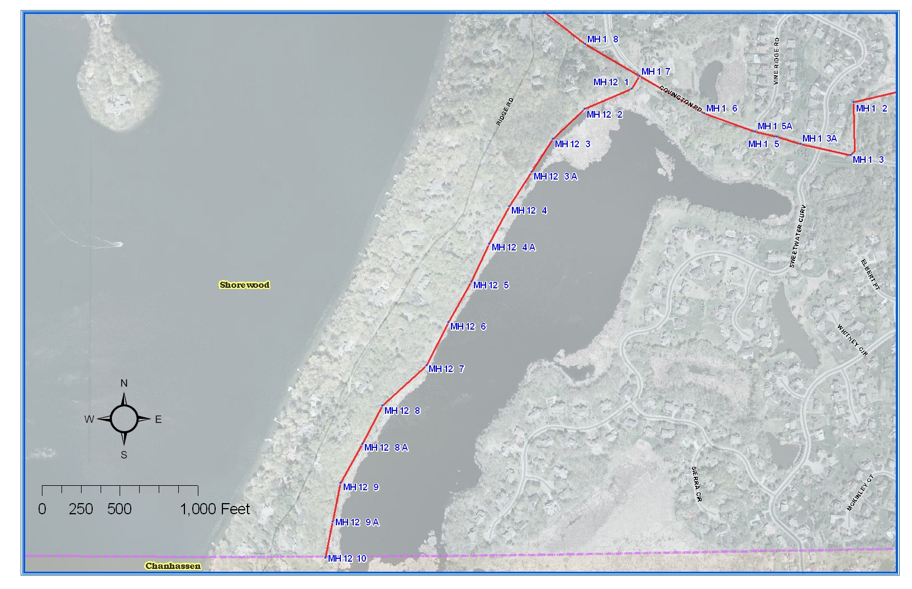

Slide 5
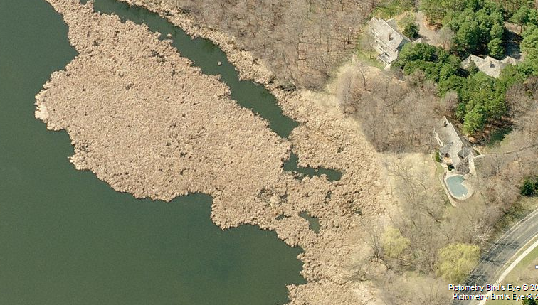
MH 12 3
MH 12 2
MH 12 1

Slide 6
Access Issues :
  Only access on north end of lake through 20’ easement
  Had to build an “ice road”
  Used snow blowers to remove snow from surface
  Allowed to freeze
  MH’s in area of bulrushes
  Still could not safety drive heavy equipment to sites.
  Used 6X6 Polaris ATV to move people and equipment.

Slide 7
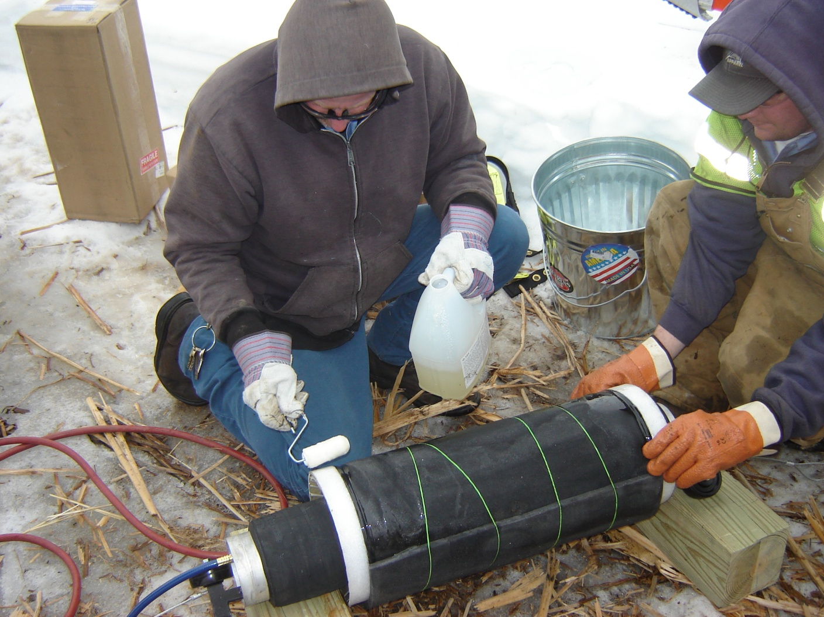

Slide 8
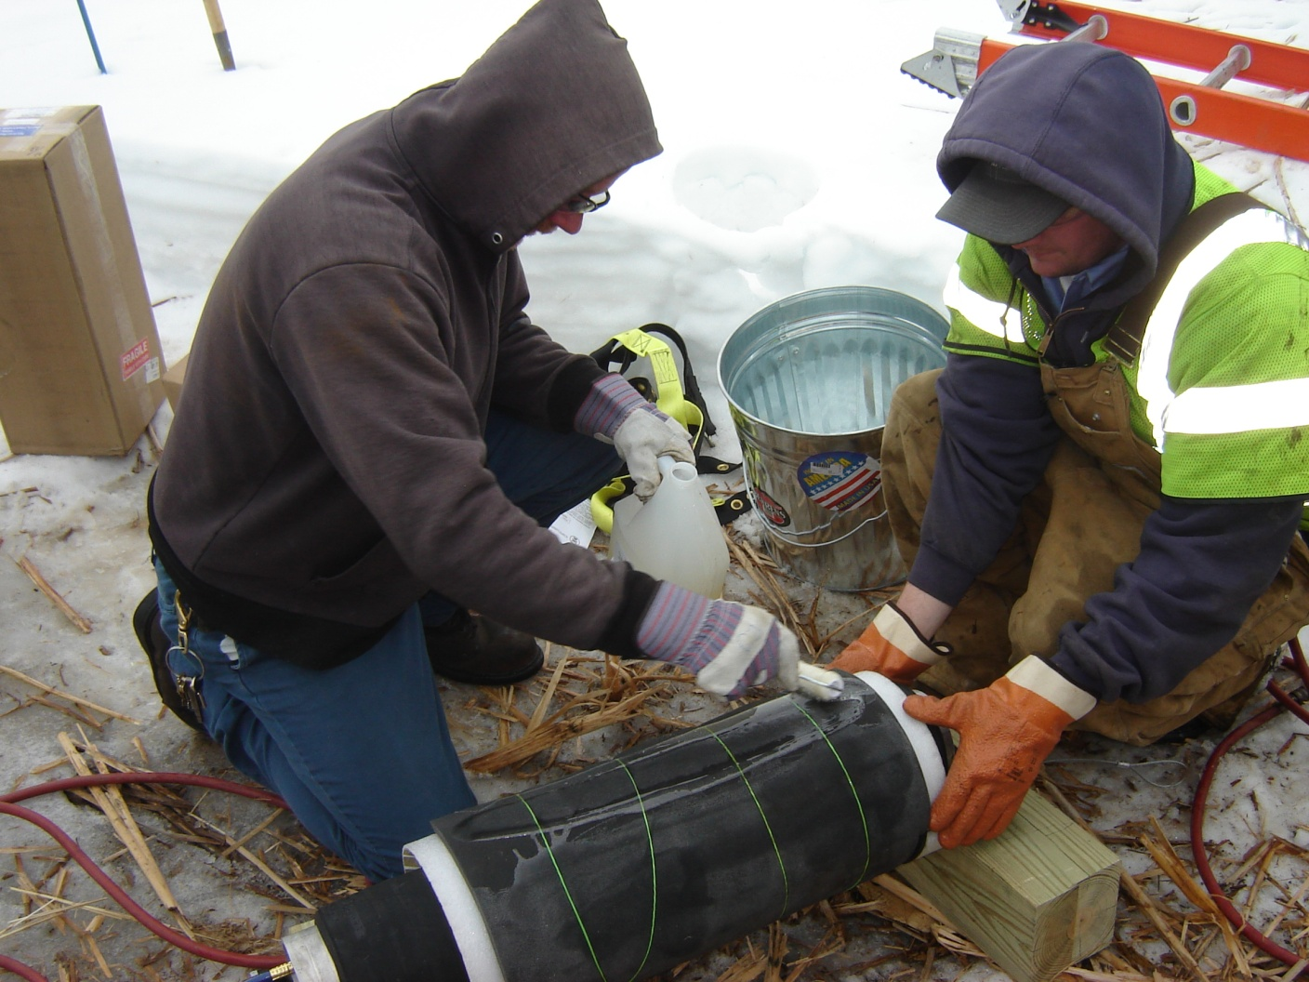

Slide 9
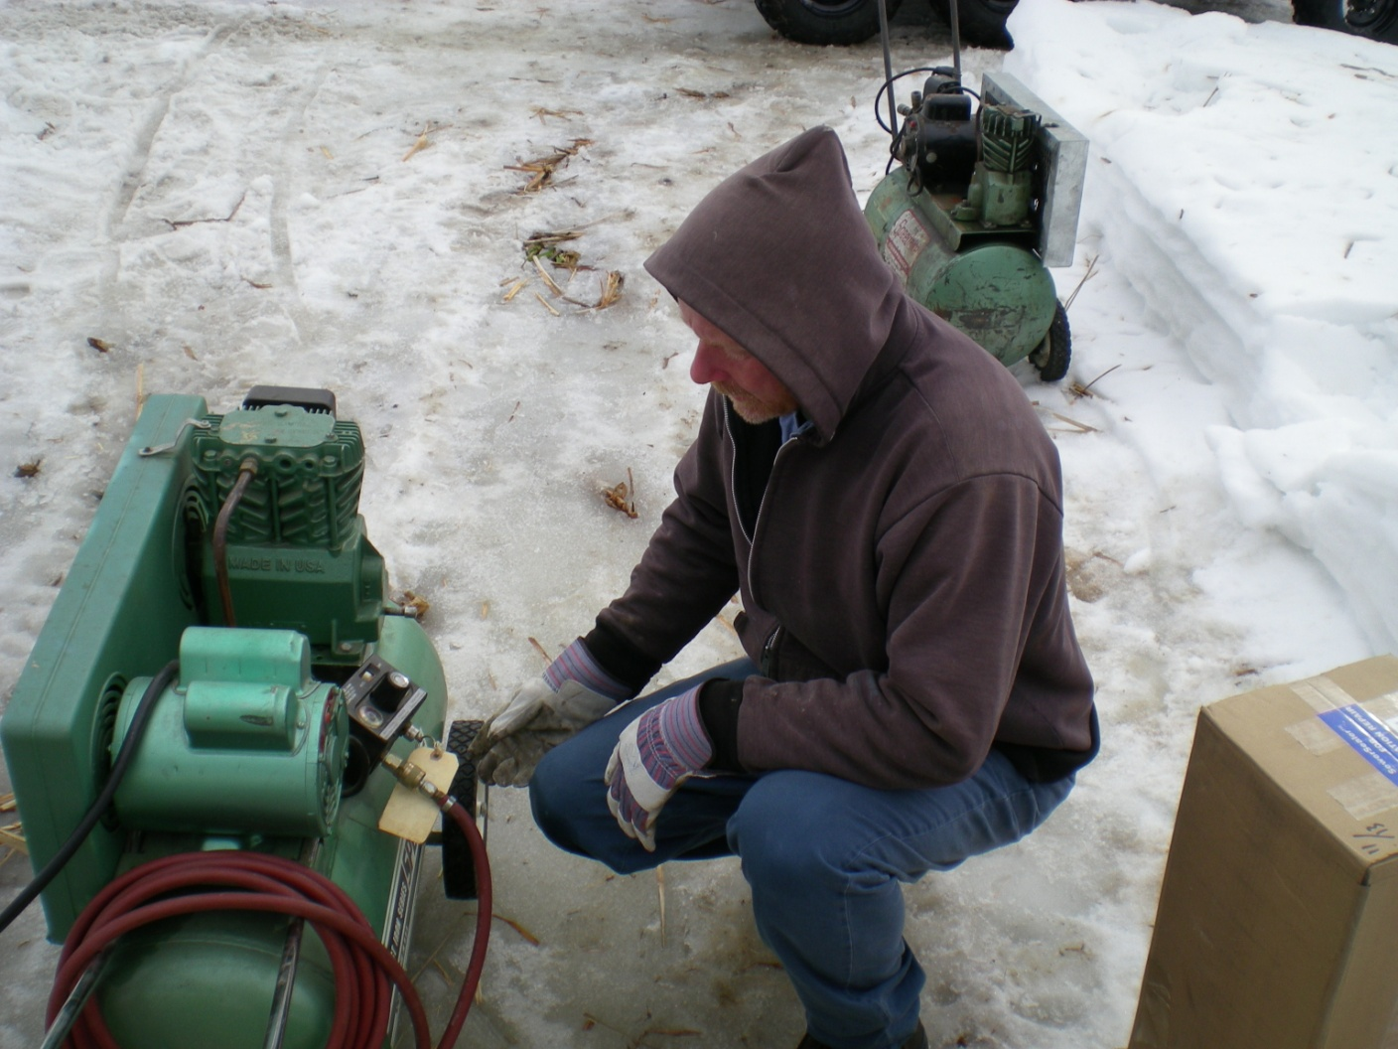

Slide 10

Eight minute movie showing installation of Link Sealer

Slide 12
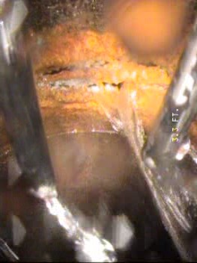
Before
MH 12 7 : 5’ downstream

Slide 13
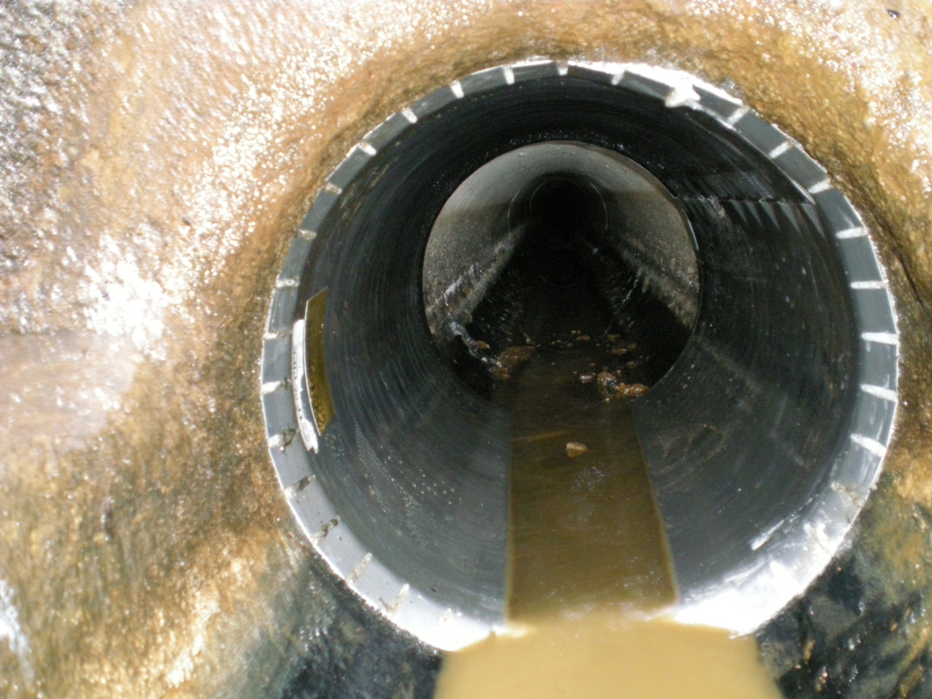
After
MH 12 7 : 5’ downstream

Slide 14
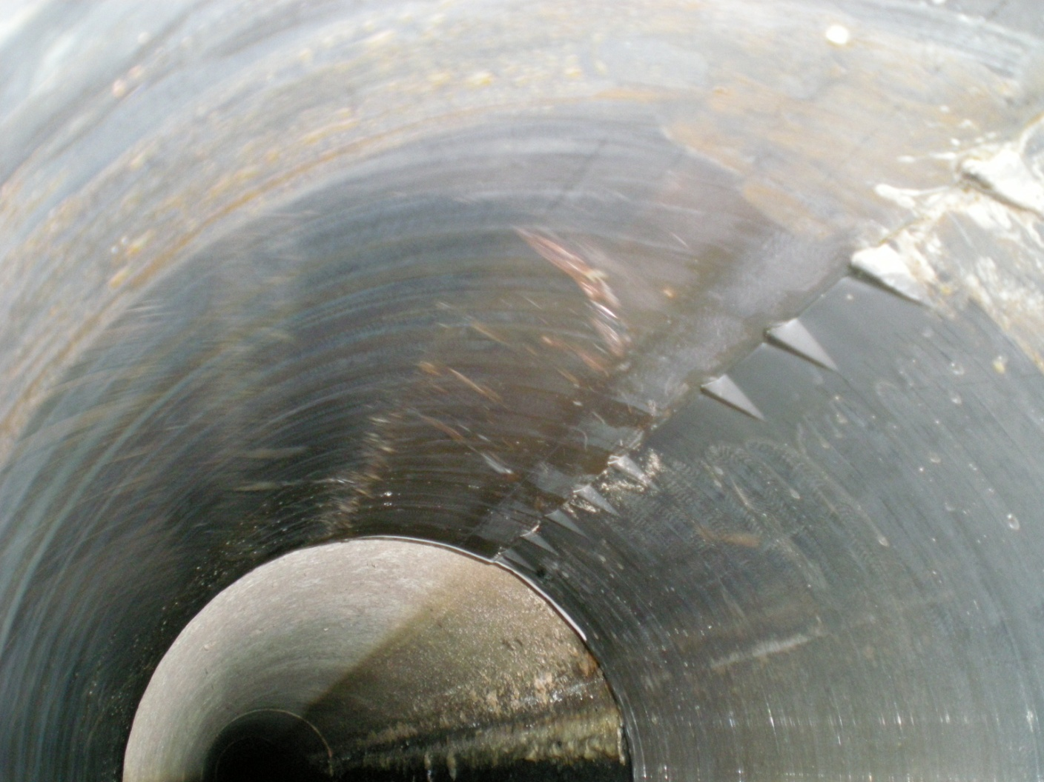
MH 12 7 : All locks fully engaged

Slide 15
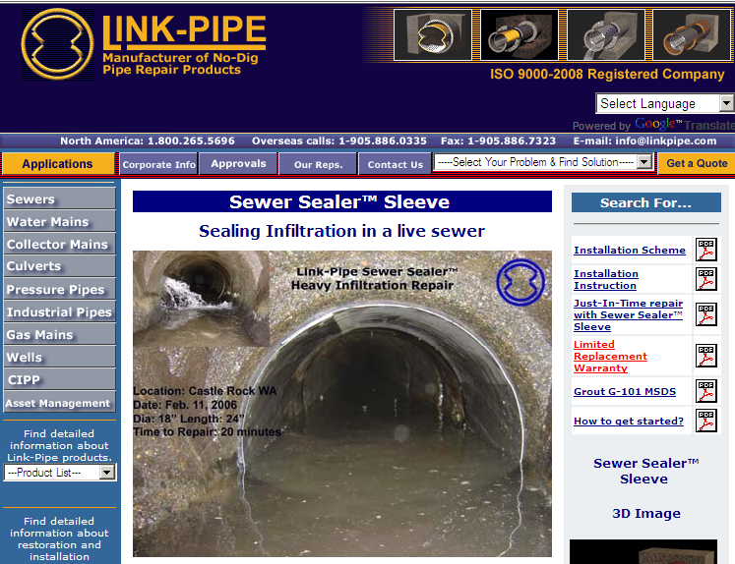
Available in sizes 6” -54”
- www.linkpipe.com

Slide 16
Questions ?

